Slide 1


SAP APM
Asset Performance Management
Stage 0 | Version 1.0
April 2025

Slide 2

Contents
Revisar al finalizar cuando todo este ok
01
Industry Challenges & Technology Evolution?
02
SAP APM Solutions within Asset Management Landscape
03
Why SAP APM? Industry Challenges & Opportunities
04
Why Accenture? How Accenture Delivers Value
05
Representative Credentials & Results
06
Value Tree

Slide 3

Industry Challenges & Technology Evolution
01

Slide 4
The Urgent Case for Change: Industry Challenges in Reliability & Performance
Asset Reliability Gaps Undermining Performance
65%
of the time equipment strategies are outdated and the PM tasks ineffective
72%
of the required asset attribute information is missing in the CMMS
18%
of installed assets are not documented in the CMMS
43%
of breakdown work orders were written against production critical equipment
50%
of all RCM implementation projects fail*
47%
of total PM hours** can be removed following RCM implementation
Emerging Industry Pressures in Asset-Intensive Sectors
82% of manufacturers believe flexibility and the ability to dynamically shift production or product mix is critical to achieving growth goals
>60% of capacity losses (after schedule losses) are due to equipment not being available to produce up to capacity
40% of global manufacturers DO NOT use analytics data recorded from connected devices to analyse processes and identify optimization possibilities
1.8x more cost to repair a failed asset than if the problem had been addressed prior to the failure
CEO
Manufacturing VP
EH&S Vice President
Plant Manager
“Growth of our core business is being jeopardized by supply chain and manufacturing disruptions”
“How can we better utilize our asset base & lower conversion costs, while relying less on capital for capacity?”
“How can we create a zero- incident company to protect our license to operate while reducing maintenance cost?”
“Every day we review yesterday’s reasons for missing production targets. Unplanned downtime is killing us”
* RCM Best Practices Study, Reliabilityweb.com ** 14 United States Military hospitals, Lance Bisinger

Slide 5

Key Challenges in Asset Management
Lack of Visibility into Asset Health
Siloed systems and limited data make it hard to assess real-time conditions and predict issues.
Inefficient Maintenance Strategies
Over-reliance on reactive or time-based maintenance leads to higher costs and wasted resources.
Safety & Compliance Risks
Asset failures can compromise worker safety and regulatory compliance.
Aging Assets & Unexpected Failures
Older equipment increases the risk of breakdowns and unplanned downtime.
Notes:
Ensure the titles are not duplicated. Please check the set of best practices.

Slide 6
Technology advancements are driving towards a holistic asset management transformation journey
With passing time, increasing pressure on margins has forced organisations to improve asset reliability through
increased focus on Asset Management
Collaborative
Proactive
5th generation:
Focus on integrated operations optimization
One maintenance process framework
Shared responsibility
Integration of plant control systems and information
Direct access to knowledge exchange and management
Company wide monitoring of KPI standards
External benchmarking
Maintenance & Reliability Excellence
4th generation:
Risk based approach
Quantitative risk assessment
Simulation software
Net present value calculation
Life cycle cost
Failure databases
Maintenance task libraries
Predictive
3rd generation:
Condition based monitoring
Smaller, fast computers
Logical decision trees
Failure mode & effect analyses
Expert systems
Preventive
2nd generation:
Dutiful overhauls
Systems for planning & control of work
Large, slow computers
Planned
1st generation:
Planned maintenance
Breakdown maintenance
Reactive
Base level 0
Fix it when it breaks

Slide 7
SAP APM Solutions within
Asset Management Landscape
02

Slide 8

SAP APM
Driving intelligent asset decisions to maximize value and performance
SAP Asset Performance Management (APM) is a cloud-based solution that helps organizations manage asset risk, reliability, and performance by leveraging data, analytics, and AI-driven insights.
Notes:
Ensure the titles are not duplicated. Please check the set of best practices.

Slide 9
Tangible Business Outcomes with SAP APM
Improve asset availability by reducing unplanned downtime.
Prioritize maintenance actions based on risk, criticality, and condition.
35% increase on productivity, travel and diagnoses activities
Integrate multiple data sources (historical, sensor data, inspections, etc.).
Enable a proactive and reliability-centered maintenance approach (RCM/FMEA).
At least 11% of reduction in production looses from less equipment downtime
10% reduction in carbon emissions Through optimized maintenance and asset strategies
Notes:
Ensure the titles are not duplicated. Please check the set of best practices.

Slide 10




How SAP APM addresses these Challenges
Predicts Failures Before They Happen
Uses sensor and historical data to enable predictive maintenance and reduce unplanned downtime.
Improves Visibility Across the Asset Lifecycle
Integrates with SAP EAM to centralize data, monitor asset health in real time, and generate insights.
Optimizes Maintenance Strategies
Supports RCM and FMEA to shift from reactive to risk-based planning and optimize resource use.
Enhances Safety and Ensures Compliance
Helps identify high-risk assets and schedule interventions that reduce safety incidents and meet regulatory standards
Notes:
Ensure the titles are not duplicated. Please check the set of best practices.

Slide 11
Asset reliability is the pivot to develop effective maintenance strategy, resulting in optimized maintenance cost
A reliable maintenance strategy focuses on preventive & predictive maintenance to reduce no. of failures and minimize corrective maintenance…
…while optimizing overall maintenance cost by finding right balance between CM & PM Cost
D
I
P
F
Effective
Maintenance Strategy
Original Design
Installation of the Asset
Point at which a failure
can begin to be
detected.
Functional Failure: Asset is no longer able to perform its function
I-P Interval
P-F Interval
Optimal Maintenance Zone
Total Maintenance Cost
Precision Maintenance
CBM/ Predictive Maintenance
PM
CBM
CM
Total
Cost of Preventive Maintenance
Asset Condition
Cost
PM/Preventive Maintenance
Ineffective
Maintenance Strategy
Insufficient Preventive Maintenance
Excessive Preventive Maintenance
CM/Corrective Maintenance
Run-To-Failure
Cost of Corrective Maintenance
Amount of Preventive Maintenance
Time
Preventive Maintenance (PM) aim should be to:
Sustain the reliability of system/asset
Avoid excessive preventive maintenance (PM)
The P-F curve explains an equipment condition w.r.t time and refers to potential failure (when a piece of equipment could fail based) & functional failure (when asset can not perform its intended function)
PM
CBM
CM
Total
Increase in PM costs
Significant reduction in CM costs
Net reduction in maintenance cost
Note: PM – Preventive Maintenance, CBM – Condition Based Maintenance, CM – Corrective Maintenance

Slide 12
The Asset Management Program has various initiative running in logical manner to reach the desired end state…
Illustrative
Connected Machine
Remote Operations
Digital Twin
Asset Intensive Industries
System Optimization & Analytics
Digital Enabled Plant
Maintenance Philosophy & Strategy
Operational Data
Maintenance Data
Predictive Maintenance Condition monitoring analytics
Asset Data Management
Asset Reliability & Lifecycle Management
Asset Hierarchy Build
Asset Criticality
ECA-FMEA-RCA
Maintenance Requirement
Maintenance Strategy Optimization
Generation of Fault Tree
Maintenance Strategy & Work Planning Management
Bill of Materials
Maintenance Task list
Maintenance Plan/Item
Maintenance Planning & Scheduling
Work Order Generation
Work Order Planning & Scheduling
Work Order Execution & Closeout
Inventory Optimization
Material Cataloging
Critical Sparing
Inventory Modelling
Stock Holding
Material Logistics
(PR & PO)
Material Reservations
Enabled by APM Solutions

Slide 13
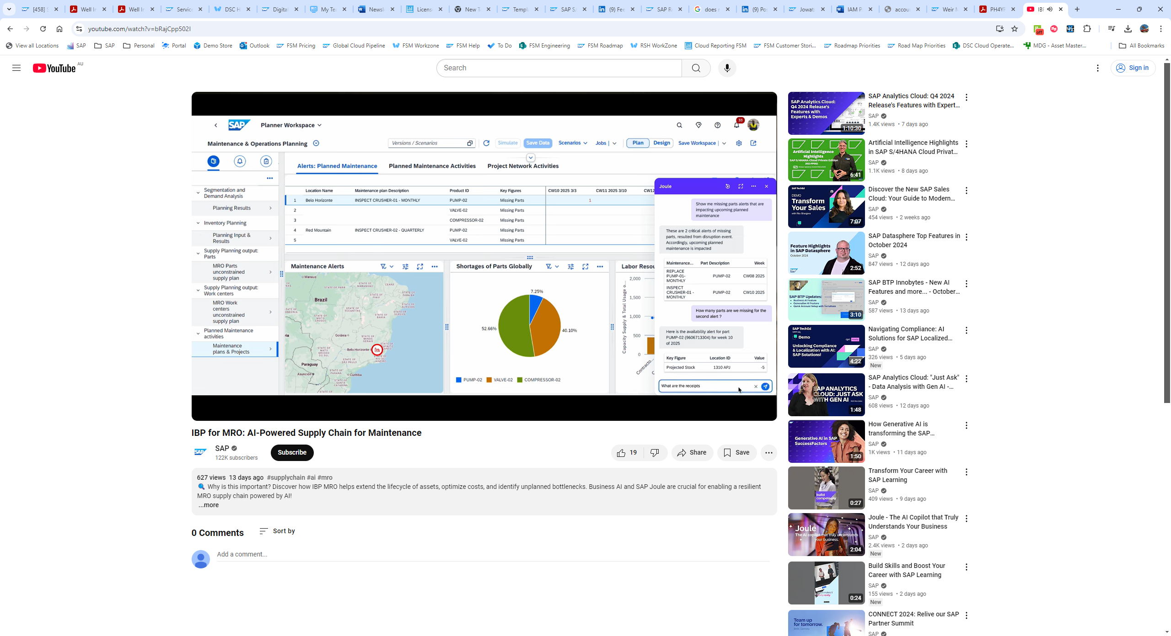
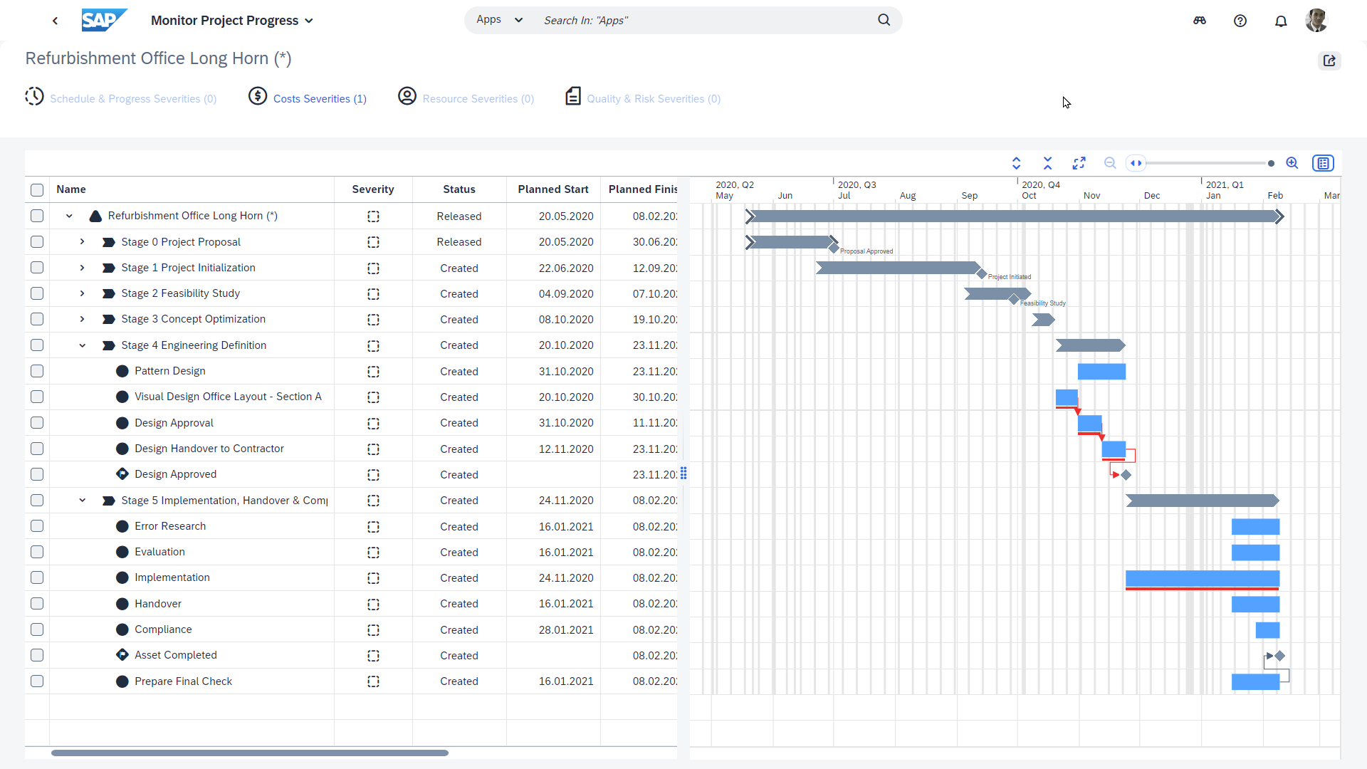
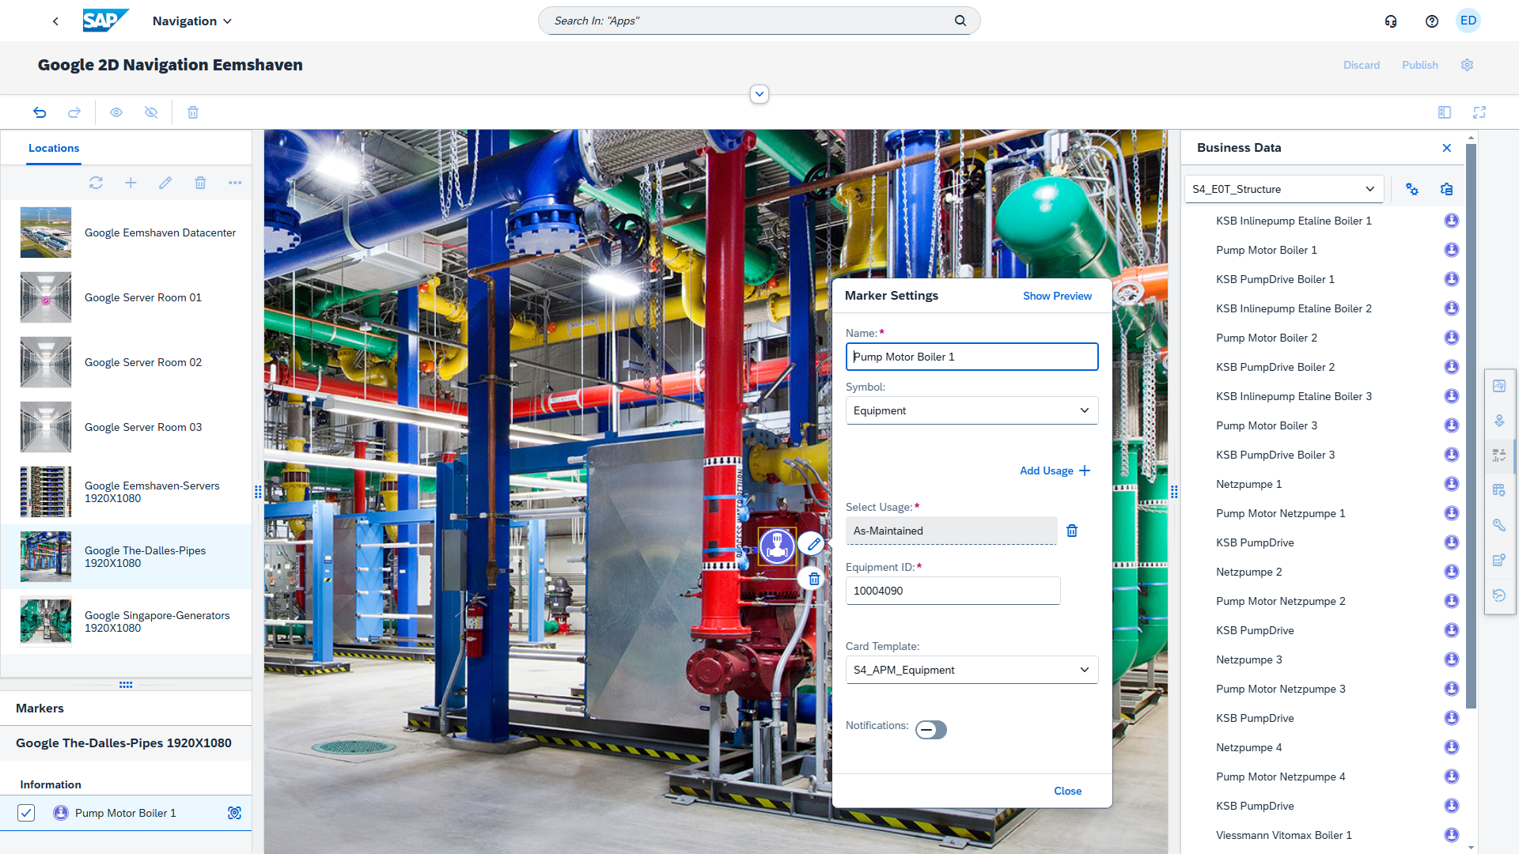
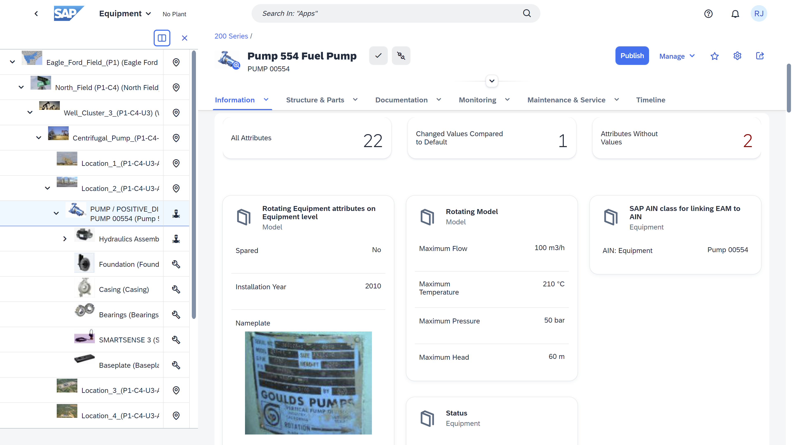
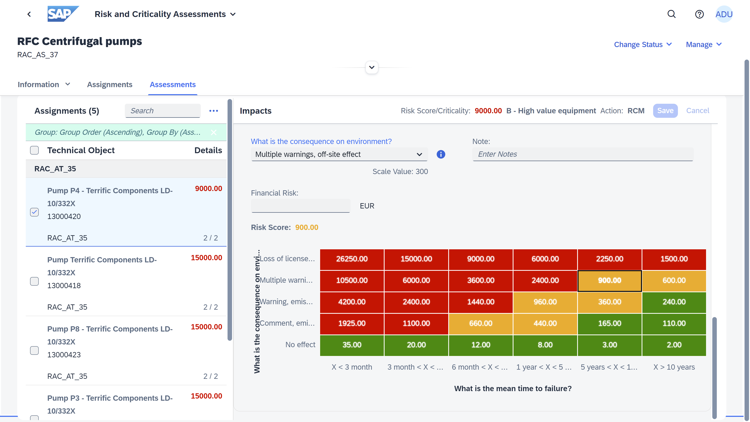
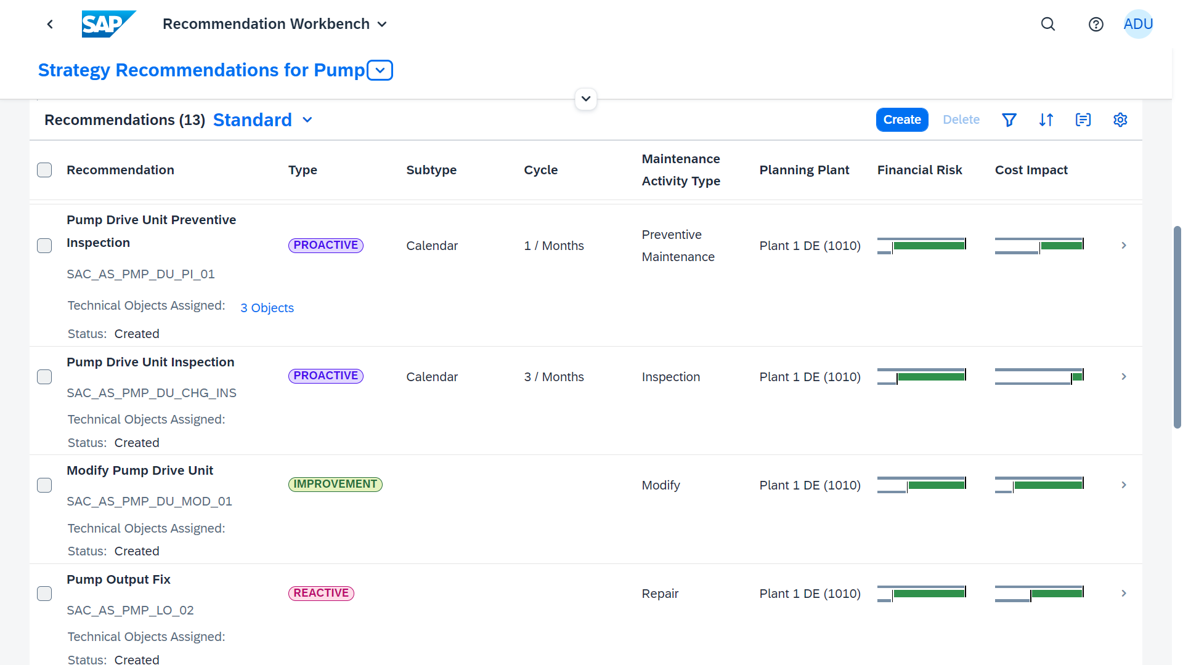
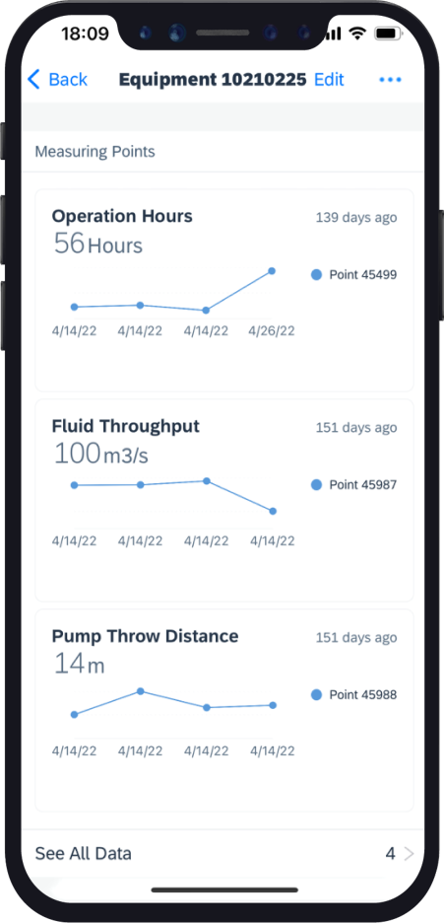
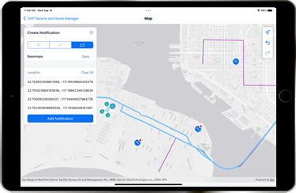
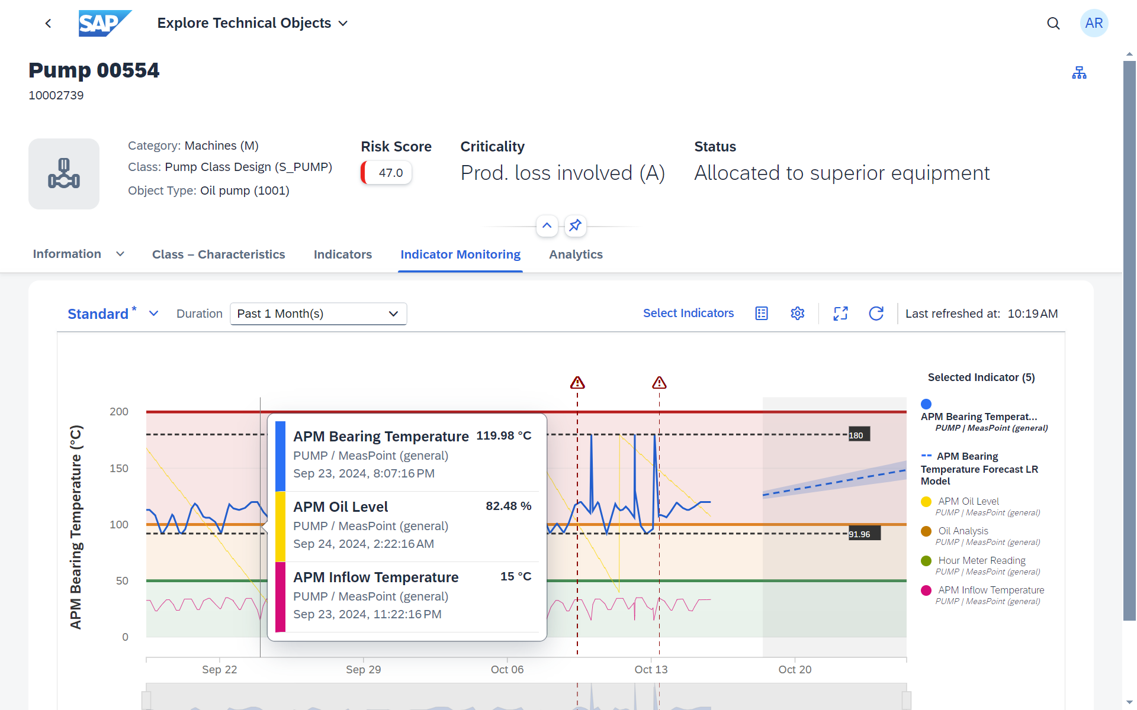

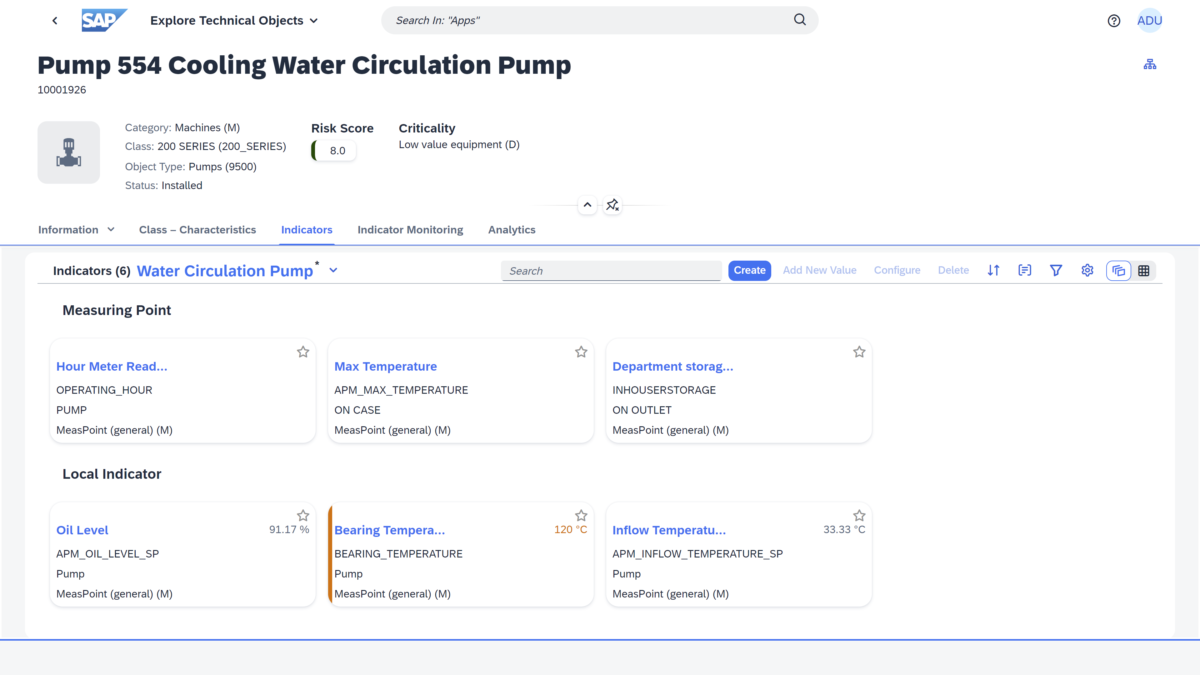
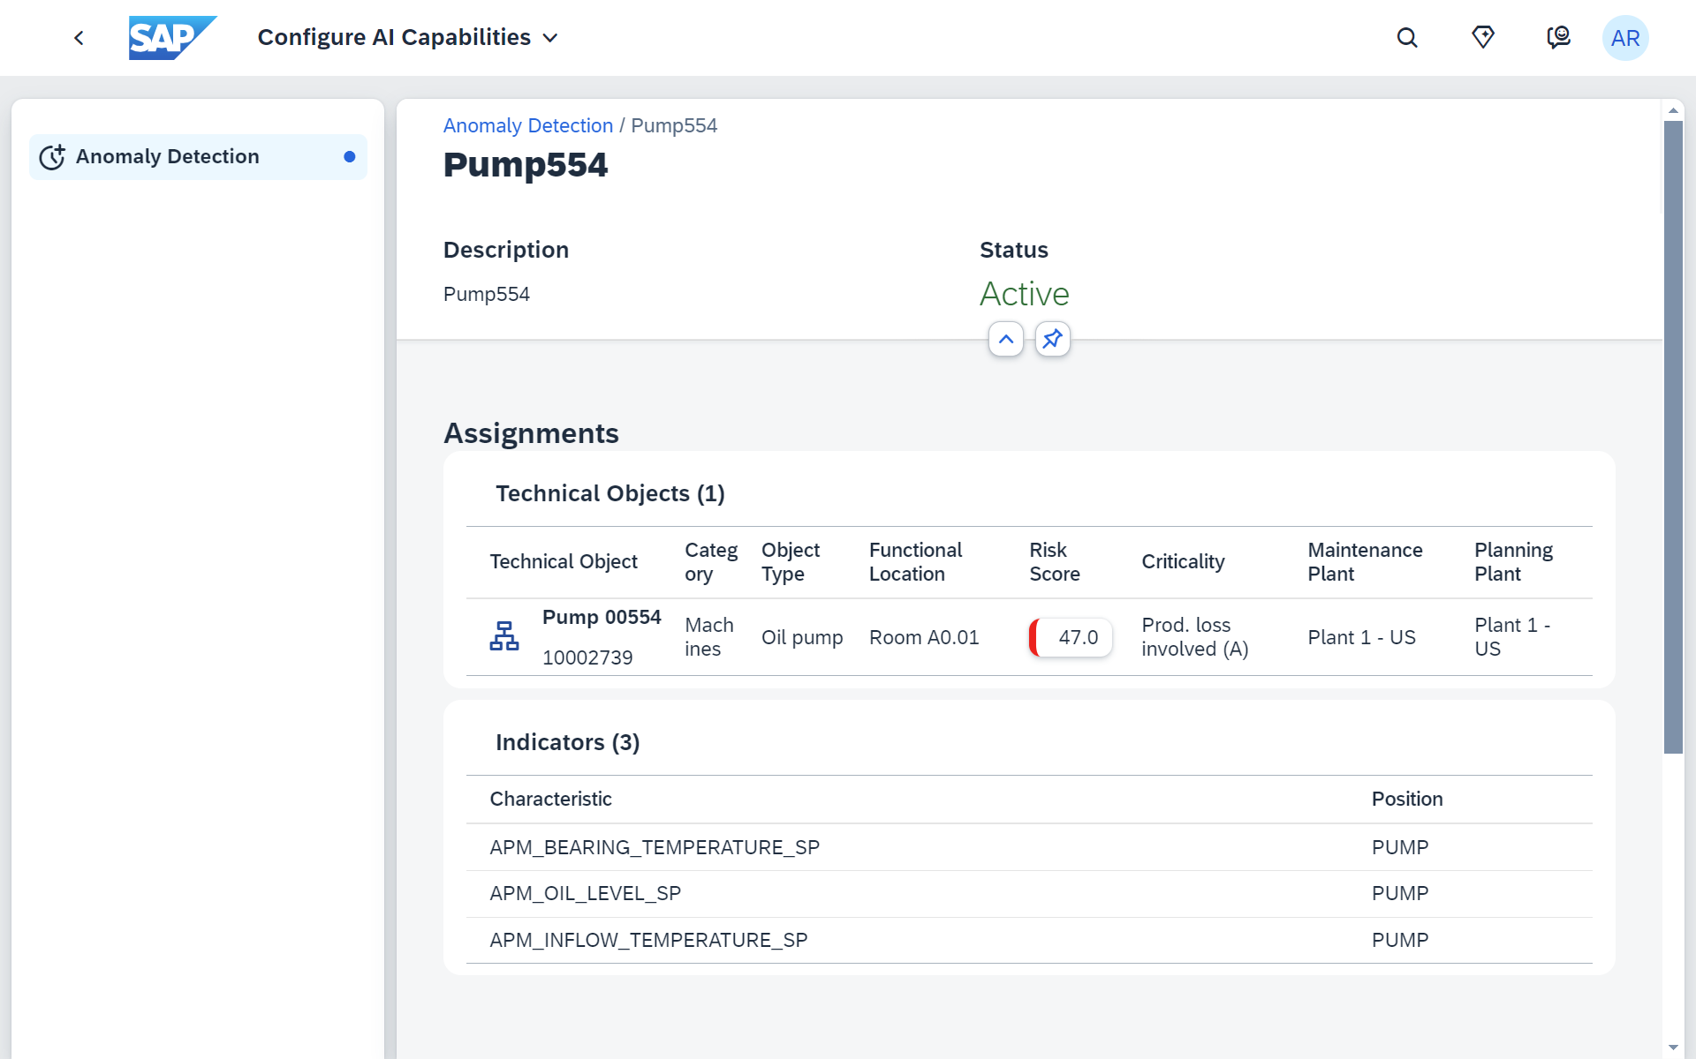
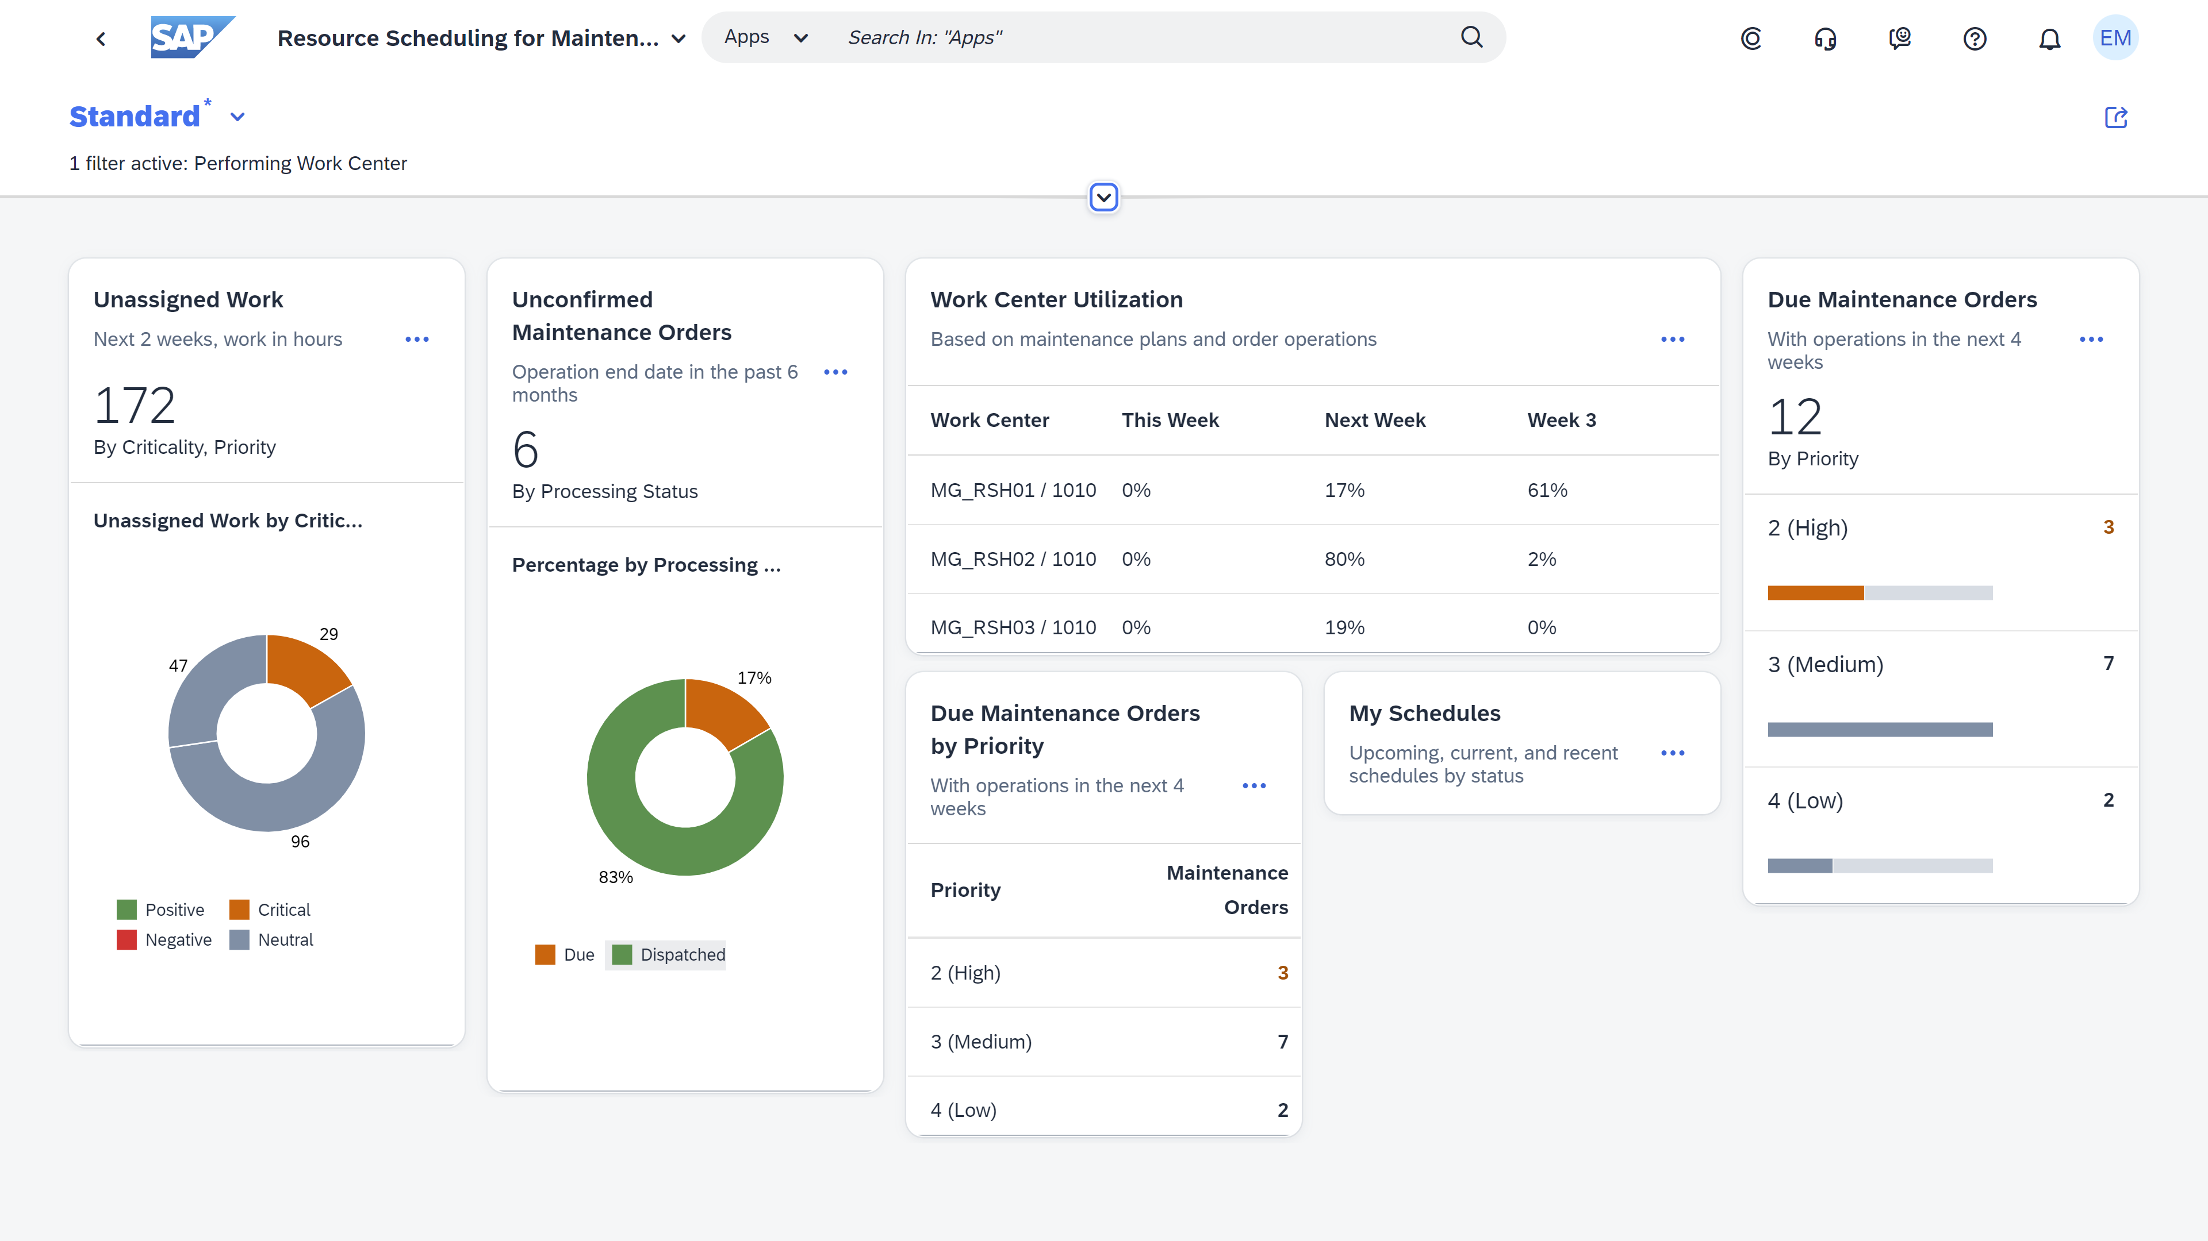
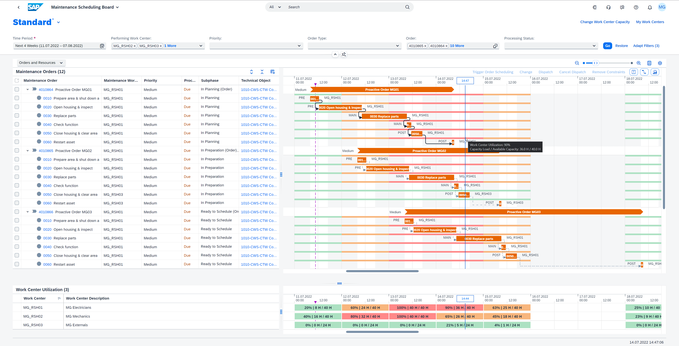
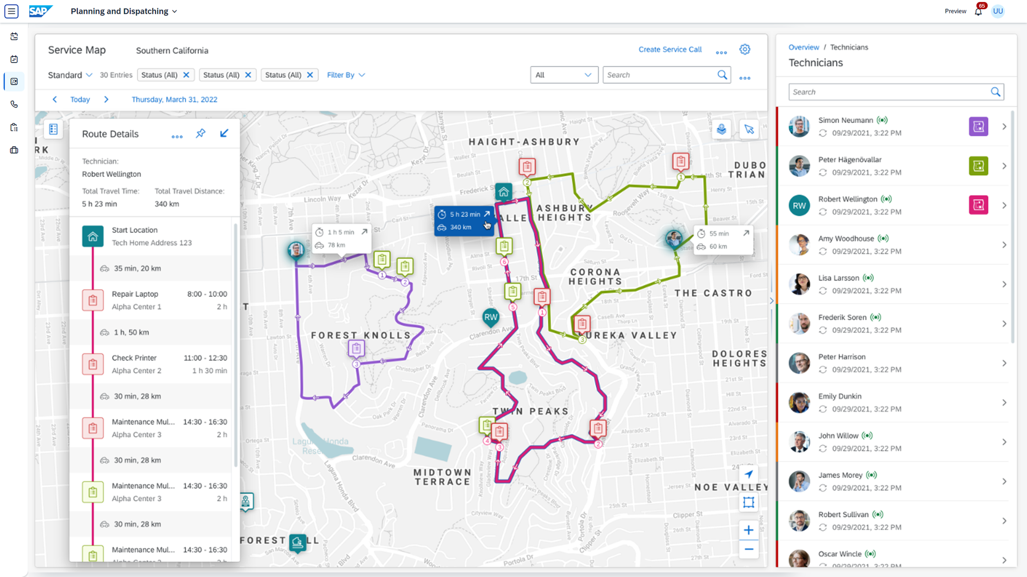
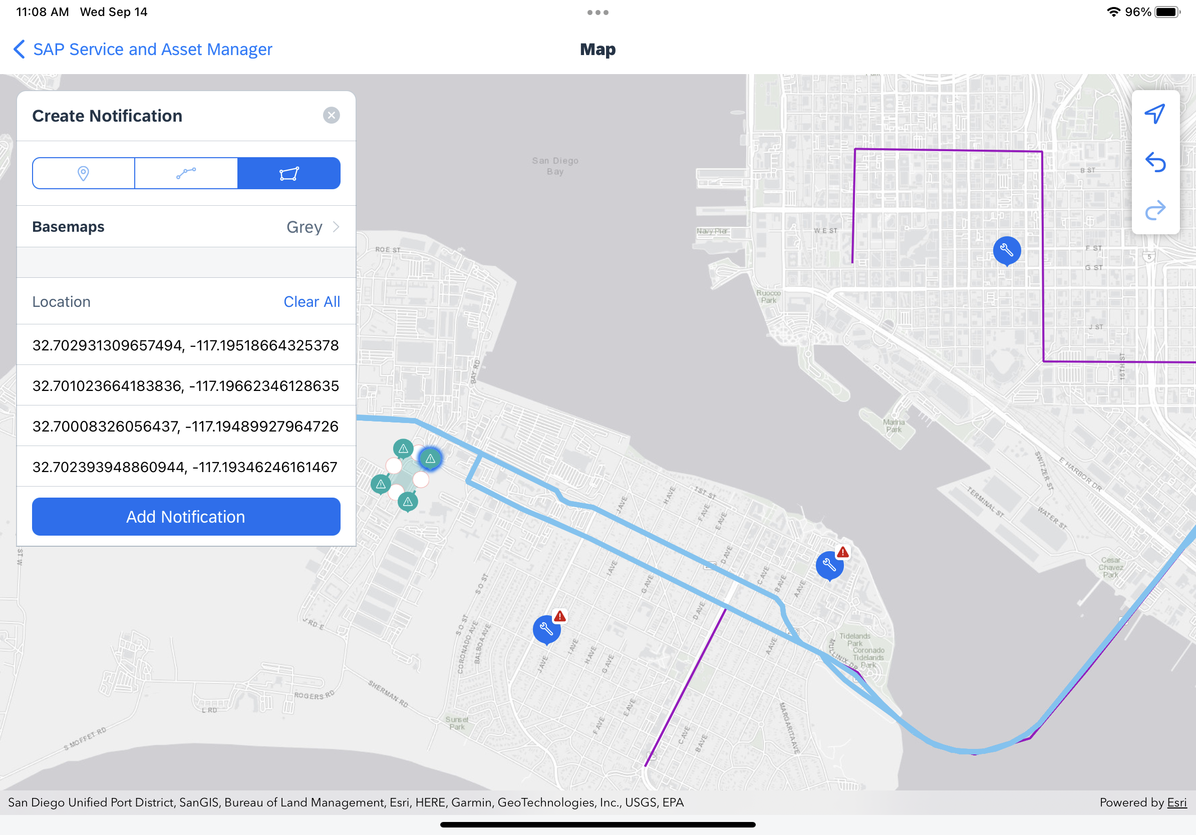
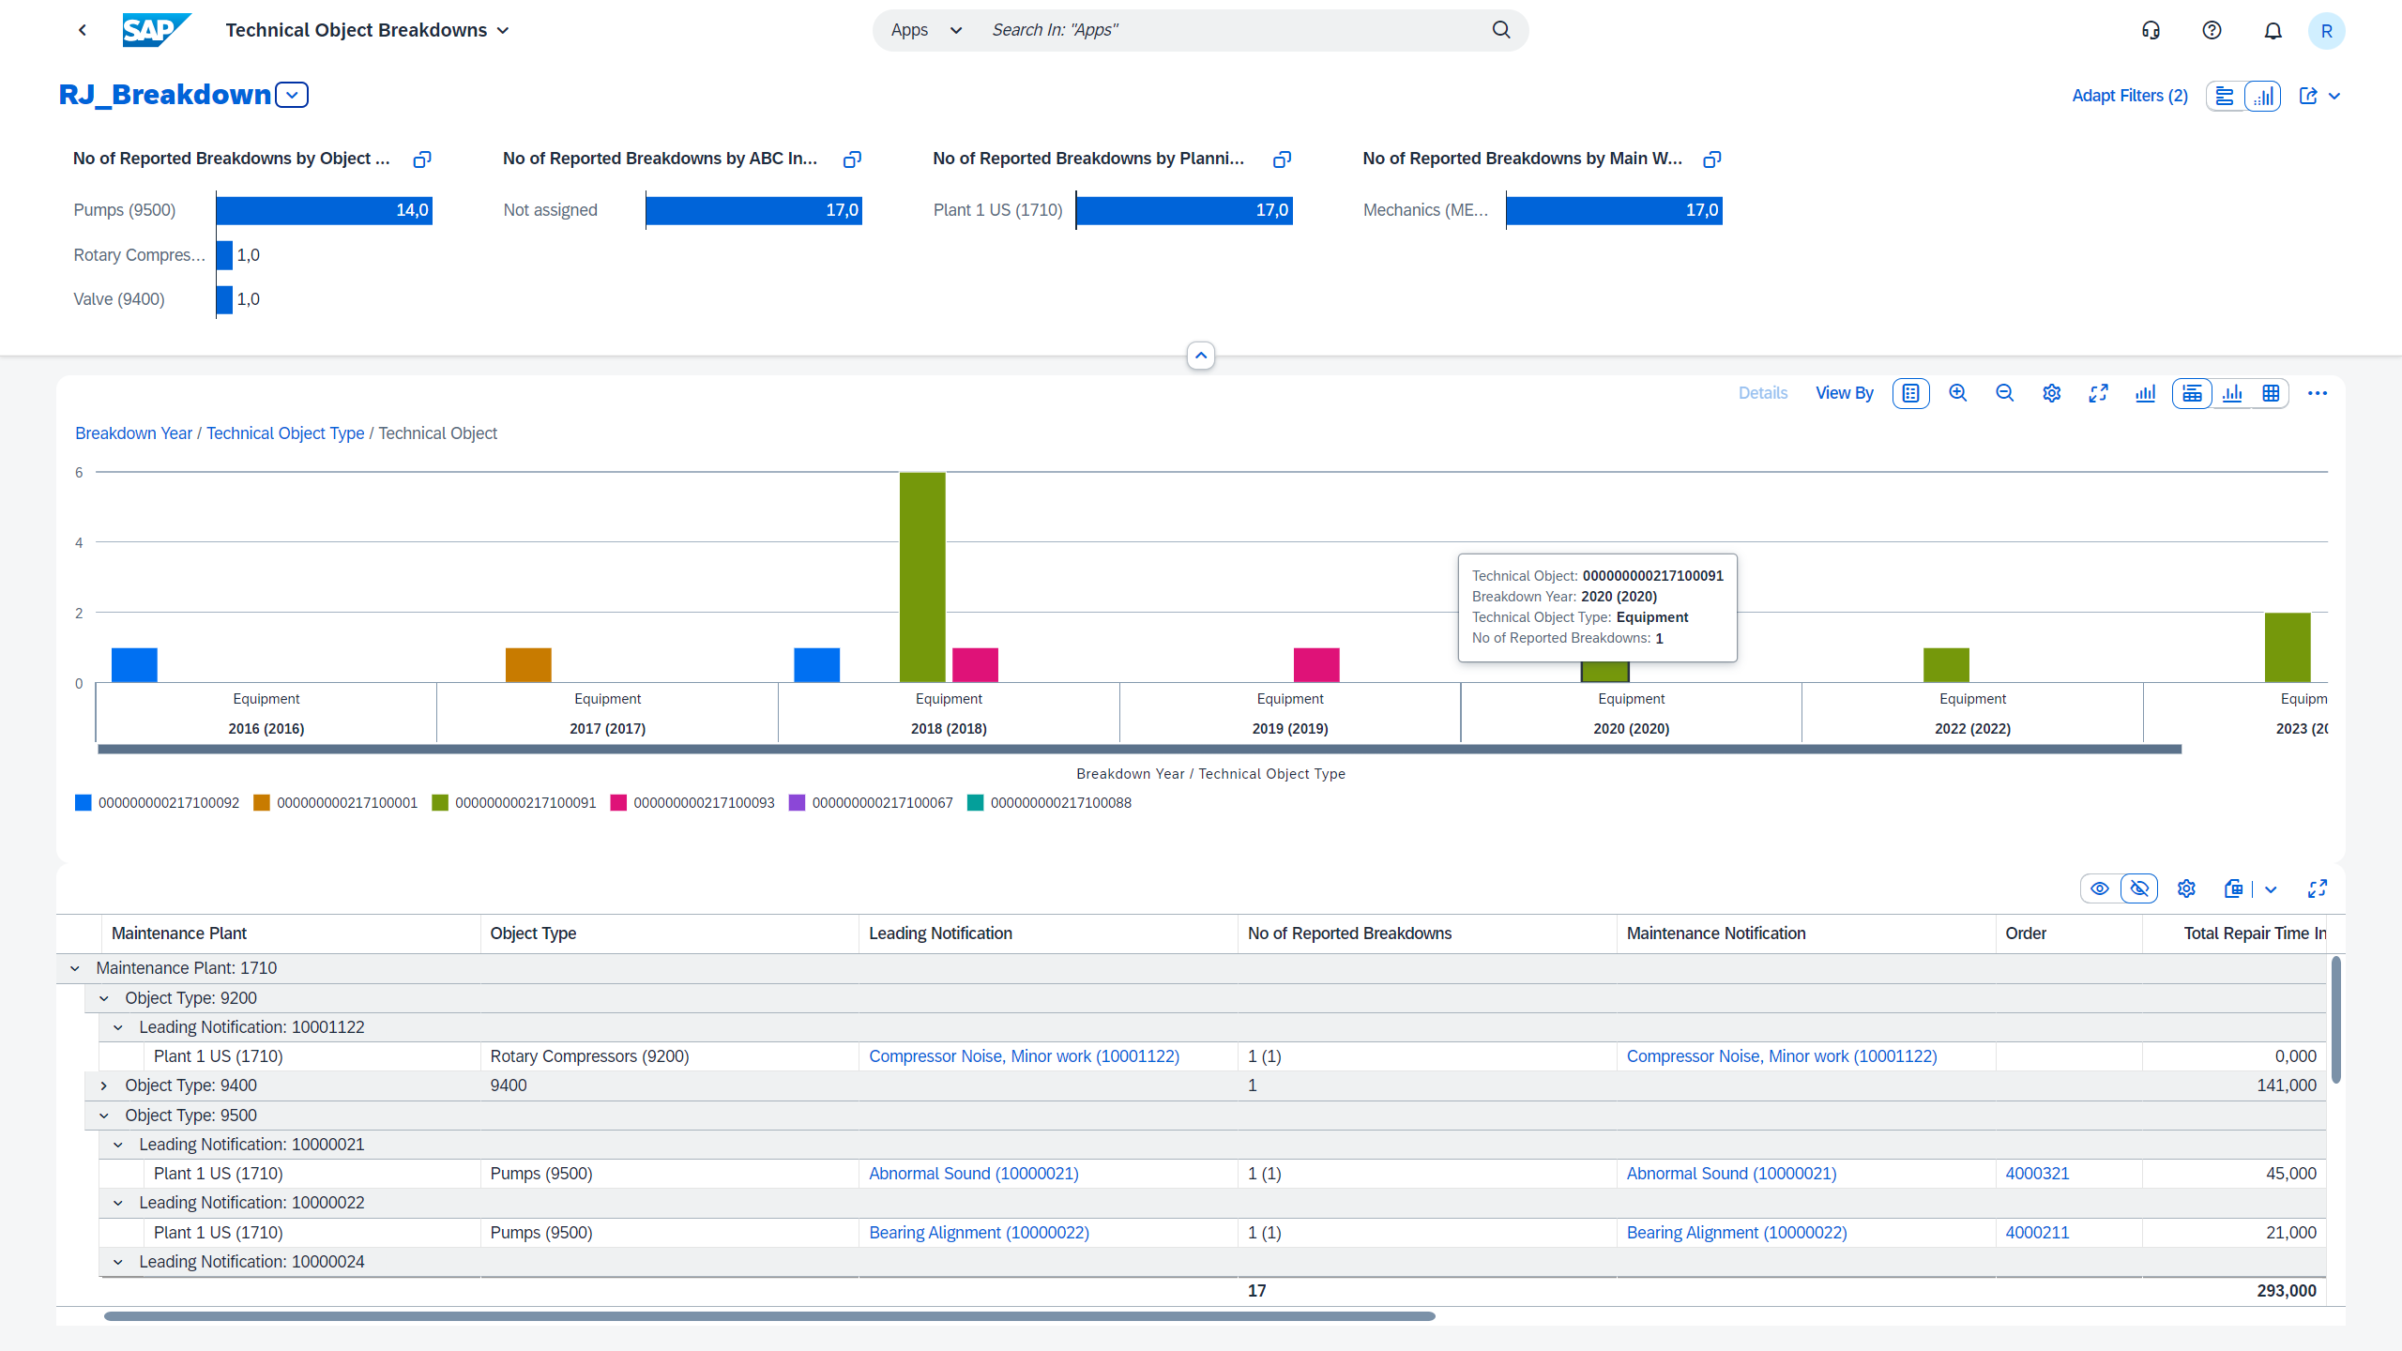

Closed-loop processes
Closed Loop Asset Life-Cycle Management Enabled by SAP S/4HANA Cloud
Investment to Commission
Reliability Assessment & Recommendation Management
SAP APM
Closed Loop with Asset Reliability Management
Asset Project Delivery
Asset Commissioning
Asset Collaboration
Asset Risk and Criticality Assessment
Implementation of Asset Maintenance Strategy
Asset Decommissioning
Strategic Asset Management Planning
Closed Loop Feedback
IoT & Inspection Data Management
Maintenance Rules & Alerts Management
Anomaly Detection & Failure Prediction
Create/Manage Orders
Asset Management Resource Planning
Schedule & Dispatch
Maintenance Execution
Confirmations and Results
SAP APM
Maintenance Cust. Service IoT/SCADA Projects
Environmental, Health & Safety
Asset Health Monitoring
Supply Chain & Inventory Management
Human Talent
Work Management
Finance, Costing & Accounting
Internal, External/Contingent Resources & Collaborative Orders
Plan, Schedule & Execute
PUBLIC

Slide 14
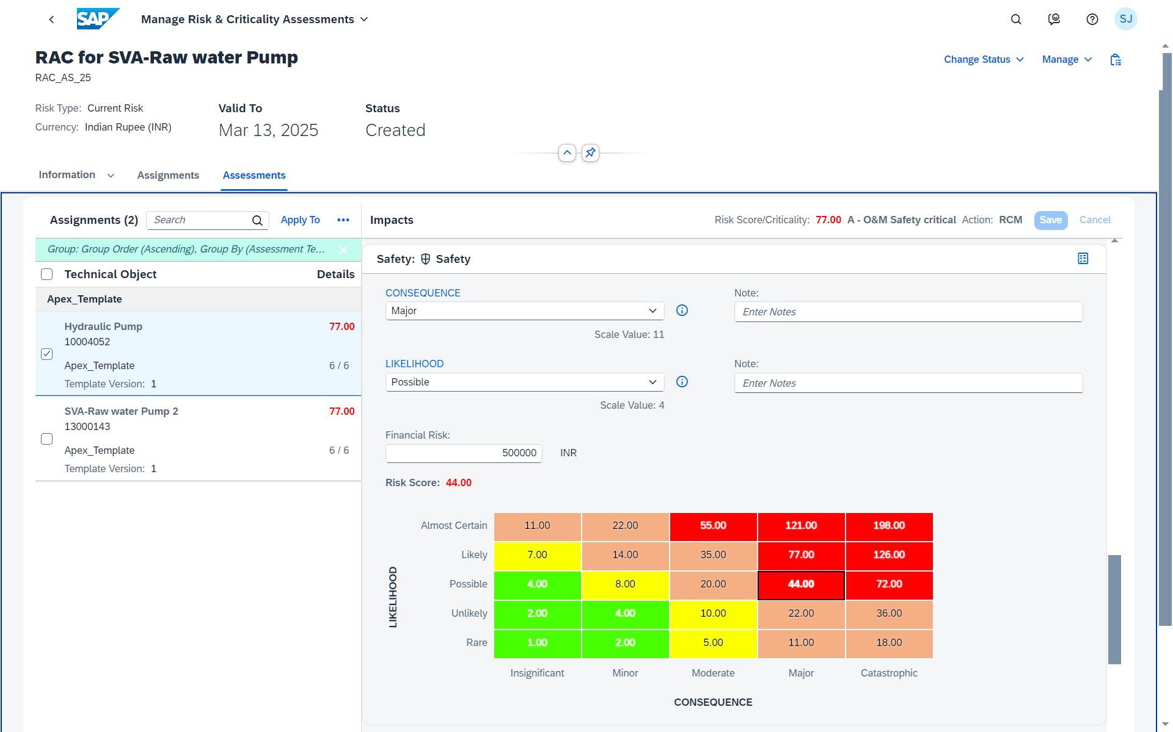
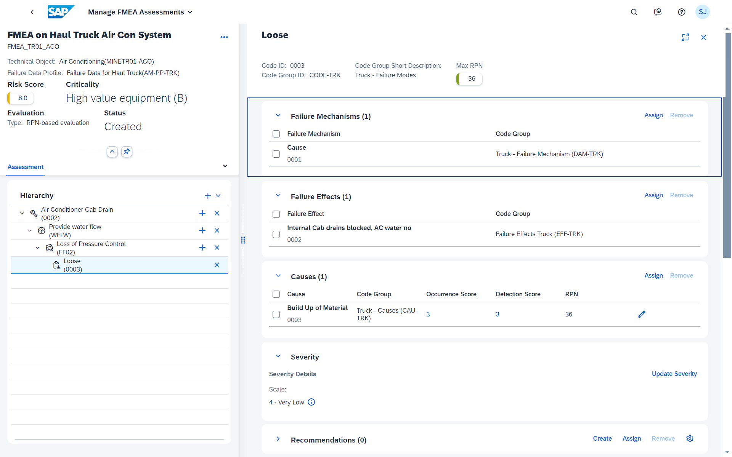
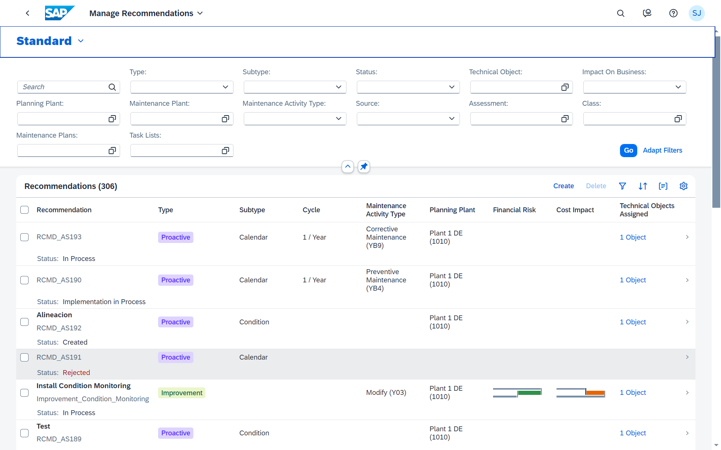
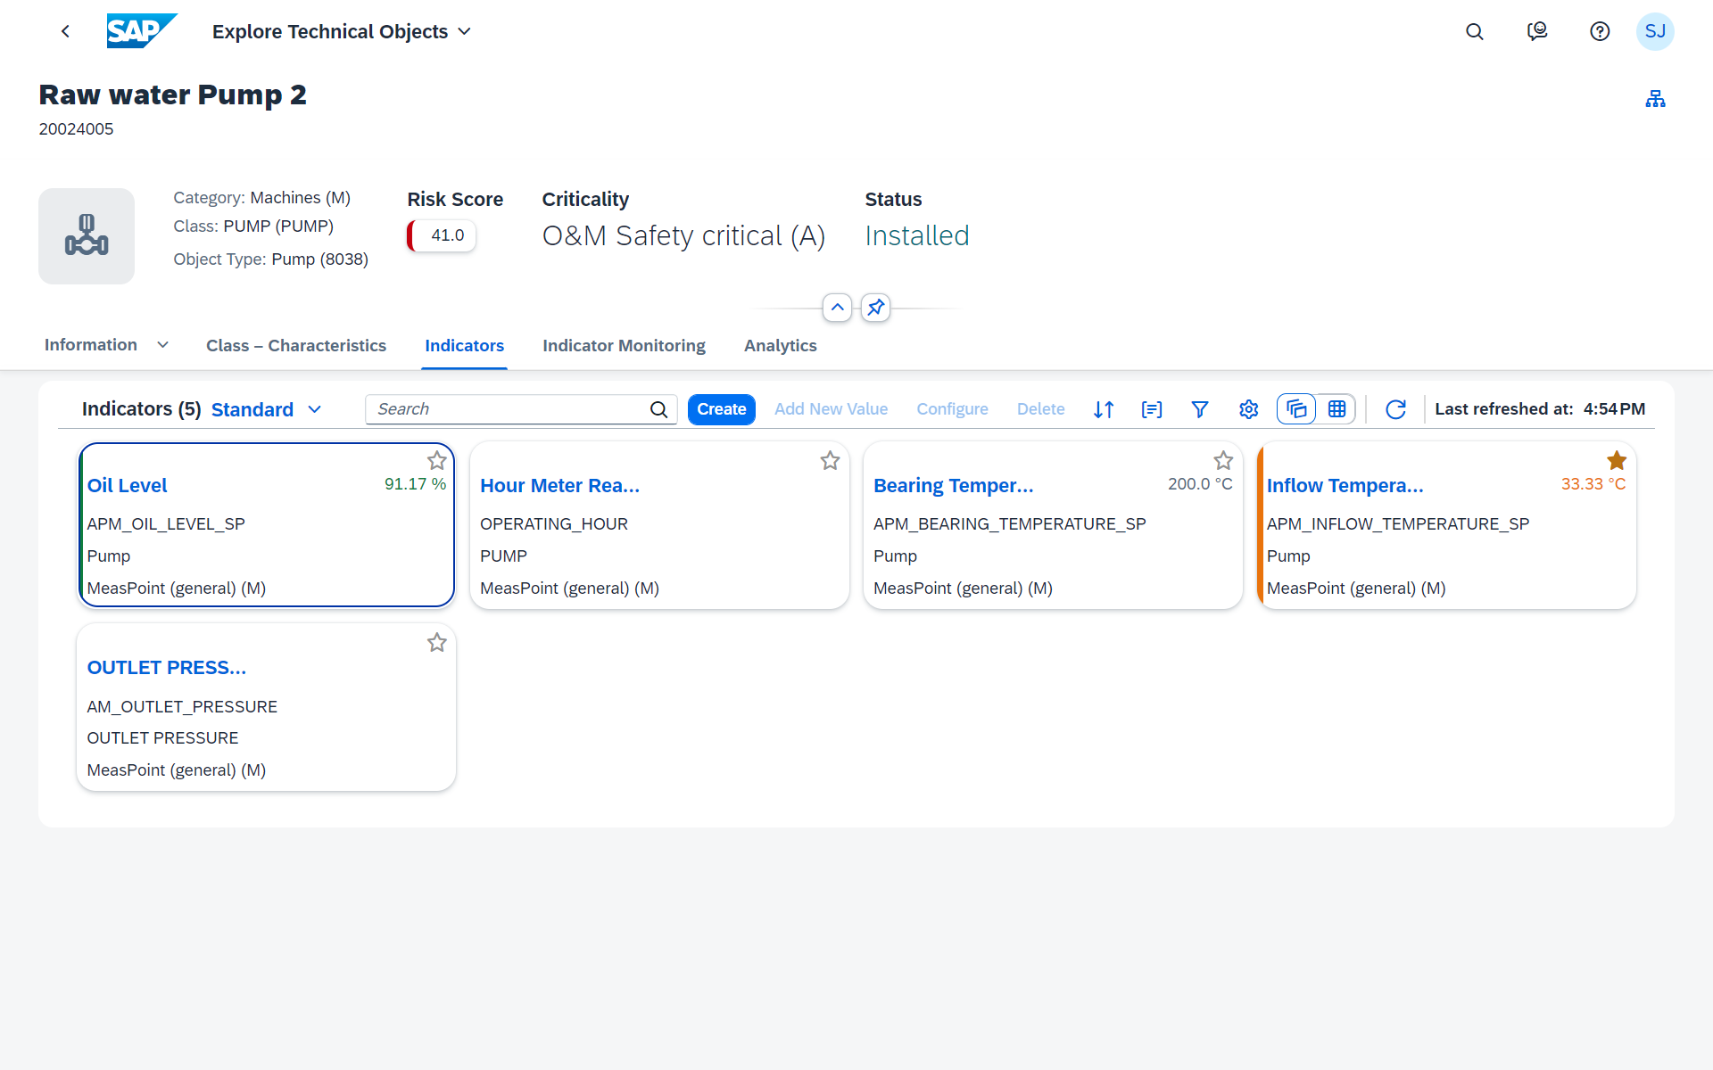
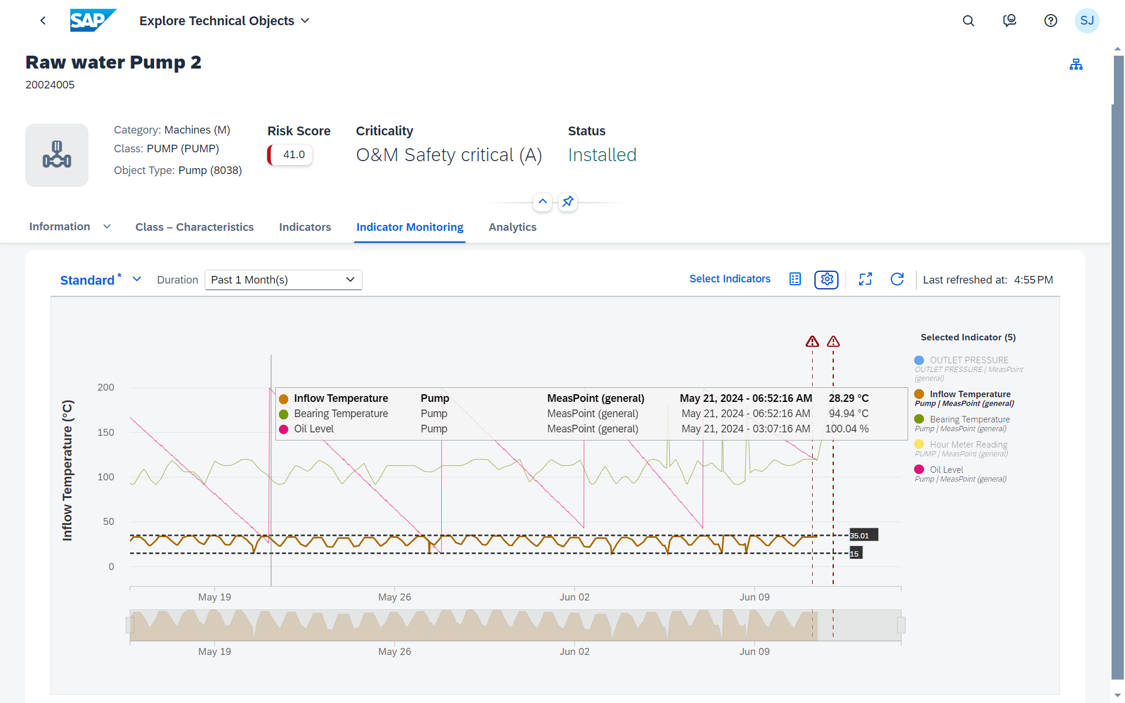
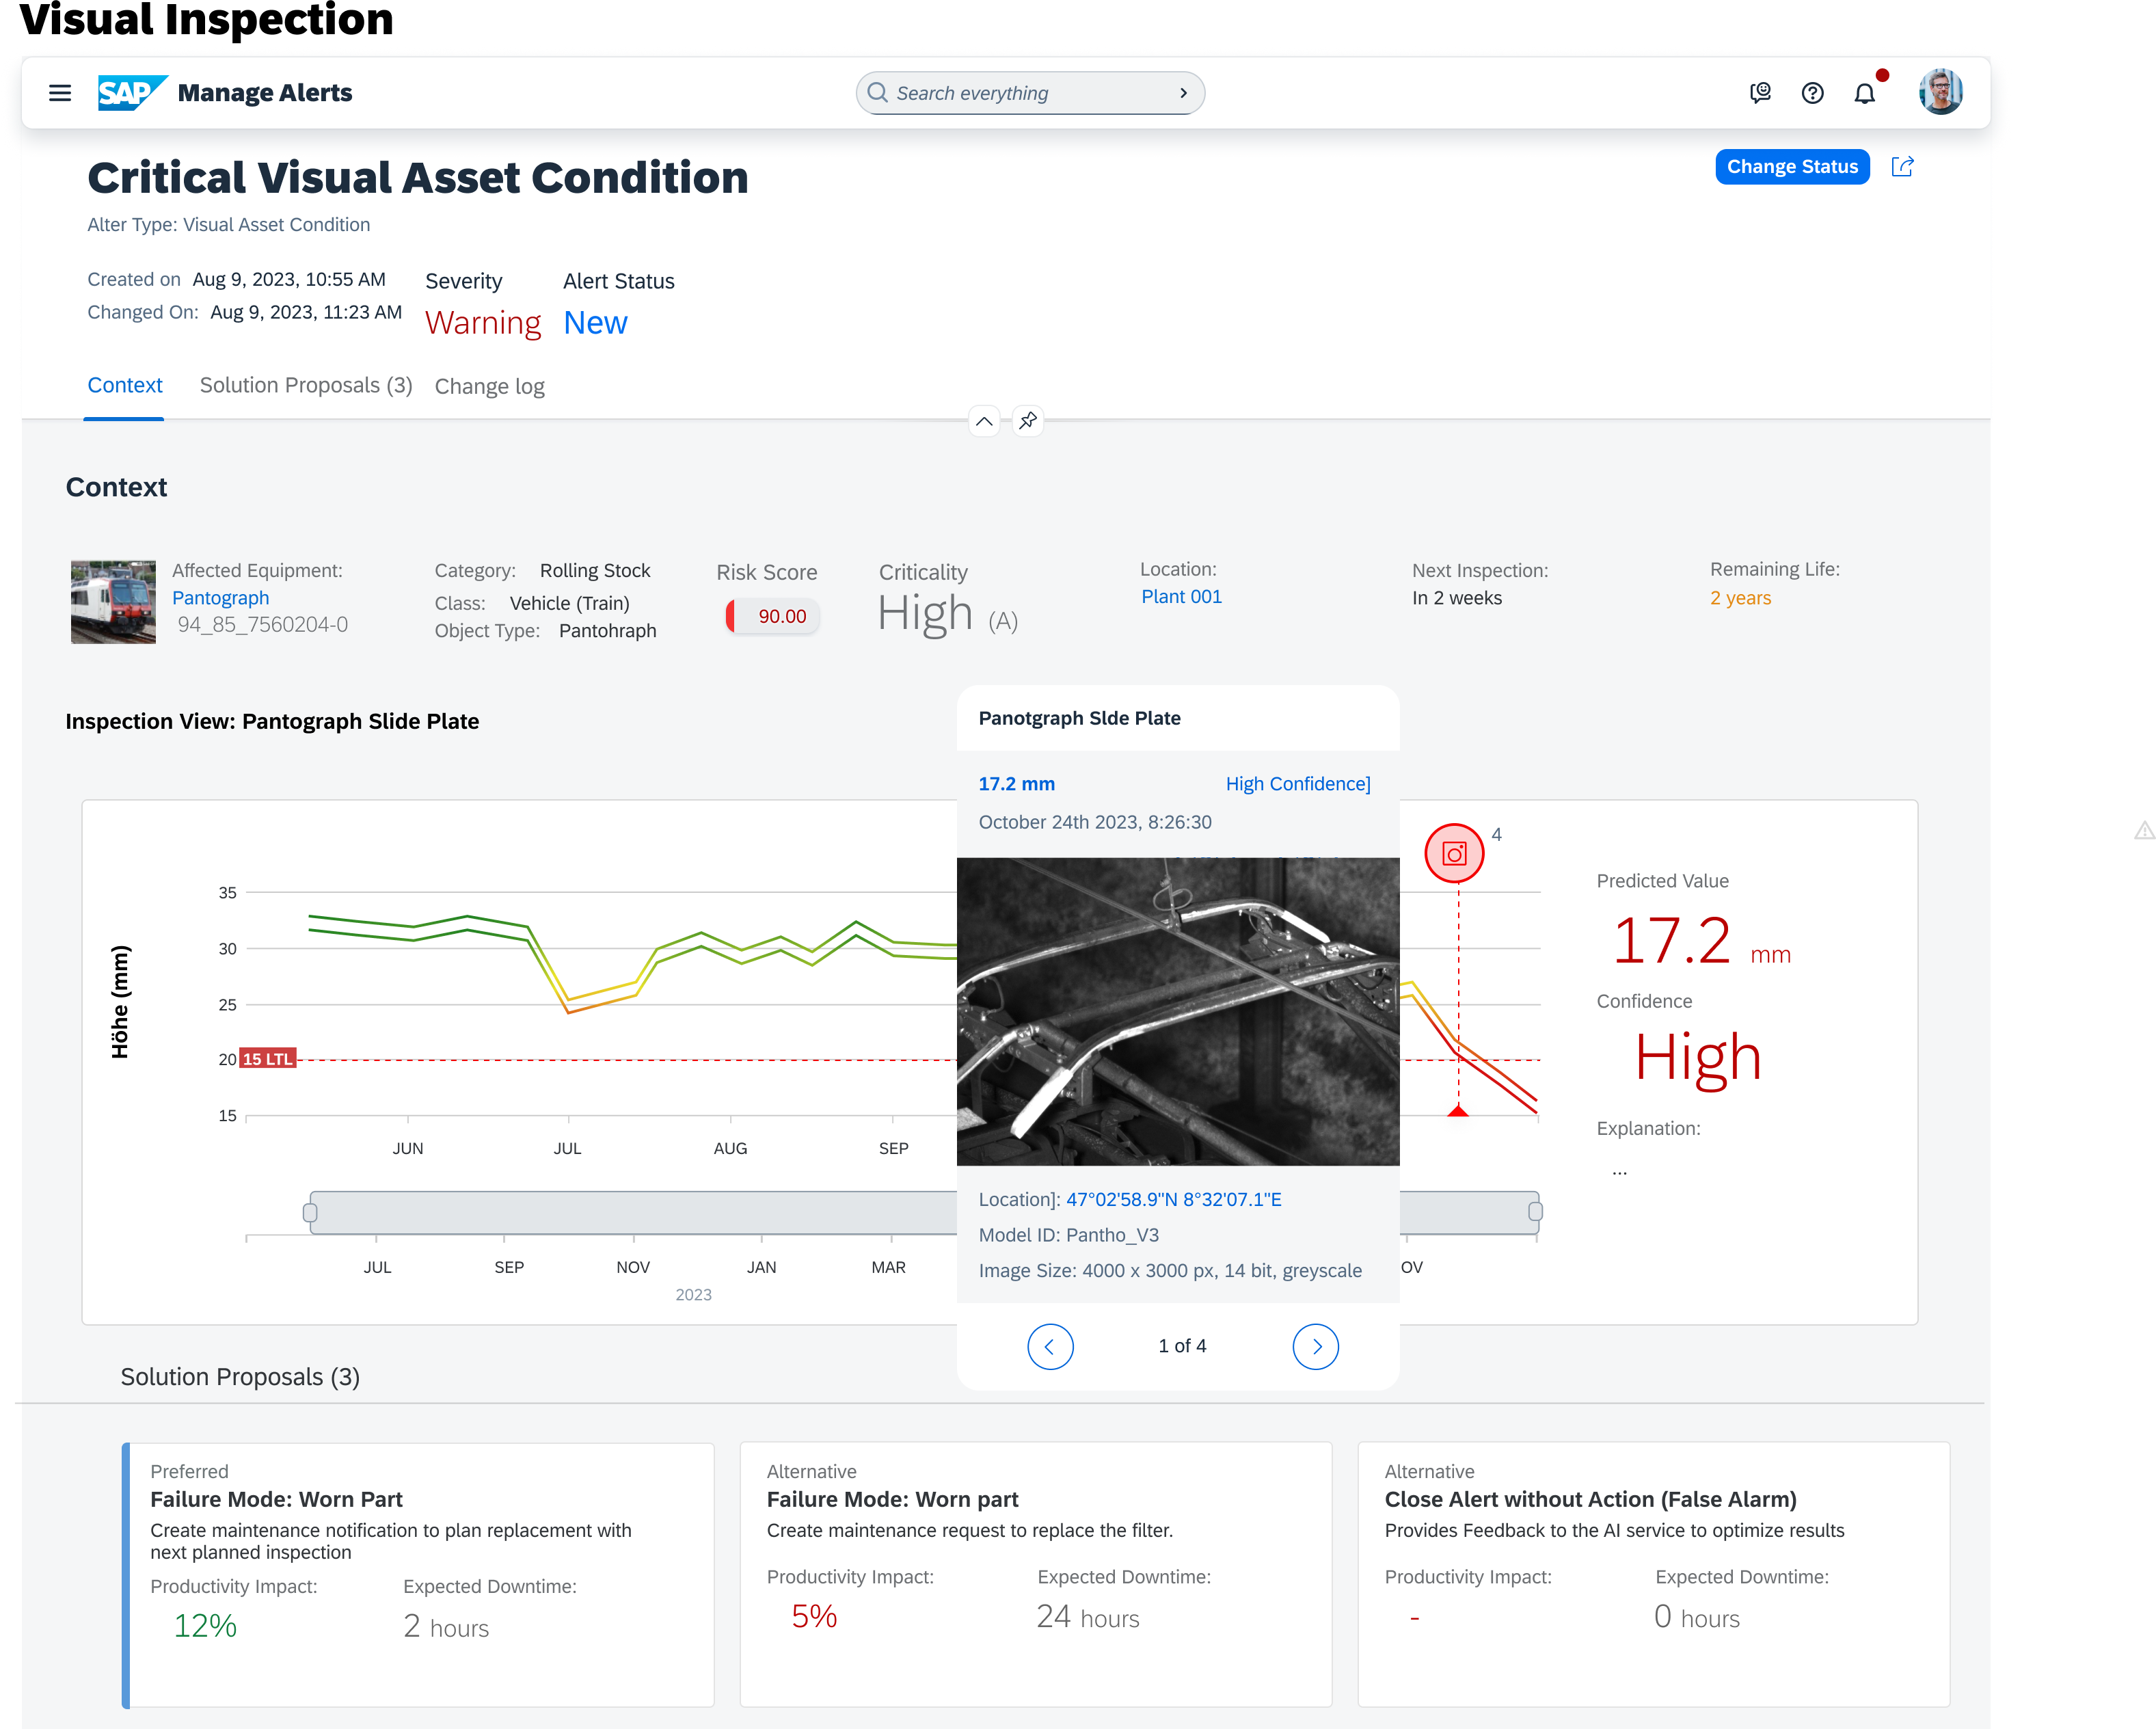
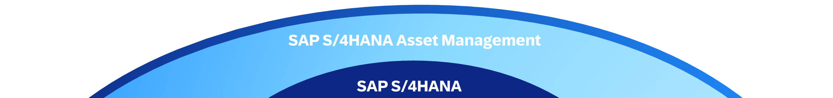
SAP Asset Performance Management (APM)
Extending asset management with asset strategy and asset health capabilities
Asset Risk Assessment Estimate and assess risk to select fit-for-purpose reliability methodologies and analyze asset performance
Asset Reliability Engineering Perform asset strategy development assessments using failure mode effects analysis, reliability-centered maintenance, and others.
Maintenance Recommendations
Centrally manage maintenance recommendations and seamless implement and track them in S/4HANA
Indicators Data Management Integrate to S/4HANA measurement points and IoT sensor data
Asset Health Monitoring
Monitor asset conditions using rule-based technologies designed by reliability engineers
AI-Enabled Predictive Maintenance Use AI and ML to detect anomalies, predict failures and assess health indicators
SAP S/4HANA Cloud Asset Management
SAP S/4HANA Asset Management
SAP S/4HANA Cloud
SAP S/4HANA
Notes:
Solution extending the S/4HANA digital core to the planning and scheduling of maintenance in the Enterprise Asset Management area. A Maintenance Planner uses relevant information to determine efficiently what work needs to be done with what resources when and where for what assets.
Vision / Roadmap topics:
Usage of Artificial Intelligence
Evolve Dispatching Scenario (Assignment of People to an operation, with topics like split at non-availability, PRT usage, exceptional non-availabilities, additional resource based views, etc.)
Enhance simulation experience (e.g. topics like duplicate schedule, compare major KPIs, move to next weeks’ schedule)
Enhance Scheduling experience in Planningboard (e.g. topics like search & jump in board, visualize utilization per shift, derive available capacity from people, etc.)

Slide 15
…and APM north star guides the evolution journey
INTELLIGENT
SMART PLANT
SELF ORGANIZING, DYNAMIC, DEMAND
DRIVEN
Integrated Asset Health Monitoring
Remote Operations Center
Connected Asset Management
Digital Twin
Cloud hosted EAM
ZB Maintenance
Spend
Video Analytics
Performance
Benchmarking
Asset Investment Planning & Management (AIPM)
SC Control Tower
Predictive Surveillance
Asset Performance Optimization
3D Printing
Risk Based Inspection (RBI)
AR/VR
SERVICEABLE / AUTOMATED
Supply Chain & Logistic Optimization
Data Governance & Analytics
Predictive Asset Analytics
Material Inventory Optimization
Robotic Process Automation (RPA)
Mobile Worker
Supply & Demand Management
Track & Trace
Digital Turnaround
Reliability Centered Maintenance (RCM)
Condition monitoring
Fleet management
Smart Work Procedures
EHS Analytics
Time based
Vendor/Contractor Management
Digital Worker
REACTIVE /
DISCONNECTED
Event based alerts
Work Control & Permitting
Life Safety
Solutions
Breakdown
Batch level
inventory control
Electronic Work Packages
Barrier Management
MANUAL
WORK/
STATIC CONTROL
Manual
Procurement
Asset Safety
Digital SOP
Dynamic Workforce tracking
Legacy driven
Basic state
Transient state
To be state
Emission monitoring & control
Reactive management

Slide 16
Why SAP APM?
Industry Challenges & Opportunities
03

Slide 17





Converge Strategy and Execution
Intelligent Enterprises
Enterprise Asset Management & Service
Asset Performance Management
Capabilities to constantly assess and improve asset availability and its output, to extend asset life, including risk and reliability management, predictive and prescriptive maintenance, and asset integrity management.
Capabilities for managing maintenance operations including planned and unplanned maintenance, scheduling work and resources, work order management and reporting, mobile support for maintenance technicians; it also covers solutions for asset acquisition and life cycle management, capital portfolio and project management, and environment, health and safety

Slide 18

APM & SAP ERP Integration View
Transform Asset Management by seamlessly extending Enterprise Asset Management with Asset Performance Management along end-to-end processes to close the loop between maintenance strategy and execution to define, implement, execute and monitor the optimal asset maintenance
Business AI
1
1
Define Asset Maintenance Strategy
Define risk and criticality for assets
Develop maintenance strategies
Define Maintenance Plan & Rule
Define time- and usage-based maintenance
Define condition-, predictive/prescriptive-, risk-based Maintenance
Monitor Asset Health and Maintenance Demand
Manage asset alerts
Initiate / screen maintenance demand
Plan Asset Maintenance, Tasks & Resources
Order planning, incl. all needed resources
Order scheduling
Perform Asset Maintenance
Order execution (also mobile)
Order/notification close-out
Analyze Asset & Maintenance Performance
Analyze maintenance strategy versus execution in efficiency and effectiveness
Manage Asset Master Data
Manage asset and asset related master data semantically aligned for both disciplines to provide a 360° view in form of a Digital Twin
Define Asset Maintenance Strategy
Analytics
IoT
2
6
Analyze Asset & Maintenance Performance
2
Define Maintenance Plans
0
3
4
Manage Asset Master Data
5
Perform Asset Maintenance
Monitor Assets Health & Demand
3
5
4
6
Plan Asset Maintenance Tasks & Resources
Mobile
Network
0
SAP AMP
SAP ERP
Notes:
Equipment Created in S4/HANA

Slide 19






SAP Asset Performance Management
Define Asset Maintenance Strategies
Maintenance & Service Strategy Development by Assessment
Strategy and Recommendation Management
Maintenance & Service Recommendation Implementation
Risk & Criticality Assessment
Segment the assets to focus on critical equipment by applying a risk-based maintenance (&service) approach
Define the right maintenance & service strategy for assets considering critical failure with the help of standard reliability methodologies including Reliability Centered Maintenance
Holistically manage failure mitigating recommendations by reviewing, consolidating and promoting them for implementation
Use the promoted maintenance & service recommendations to bring them into execution
Reliability Engineer
Reliability Engineer
Reliability Engineer
Planner

Slide 20
Risk & Criticality Assessment
Maintenance & Service Strategy Development by Assessment
Strategy and Recommendation Management
Maintenance & Service Recommendation Implementation
Segment the assets to focus on critical equipment by applying a risk-based maintenance (&service) approach
Define the right maintenance & service strategy for assets considering critical failure with the help of standard reliability methodologies including Reliability Centered Maintenance
Holistically manage failure mitigating recommendations by reviewing, consolidating and promoting them for implementation
Use the promoted maintenance & service recommendations to bring them into execution
Strategy Assessment for Classes (Mark as Template)*
Create/Assign /Remove Recommendations
Standalone
Recommendations
Proactive- Condition Based
Assing/Create Maintenance Task List*
Include leading Failure Modes in Recommendations*
Risk and Criticality Template
Copy Template
Copy*
Create/Assign /Remove Recommendations
Reactive
Strategy Assessments for Classes
Review Consolidate* and Realese Recommendations
Review and Implement Recommendations*
Assing/Create Maintenance Task List*
Risk and Criticality Assessments
Create/Assign /Remove Recommendations
Use as Template to Quick Start
RCM/FMEA
RCM Assessments for Individual Technical Objects
Actions**
Assing/Create Maintenance Task List*
Manage follow-up actions **
FMEA Assessment for Individual Technical Objects*
Create/Assign /Remove Recommendations
Proactive- Performance/ Calendar Based
Configure RPN Questionnarie*
SAP APM
- - - -
*- Planned
**- Future
SAP EAM

Slide 21
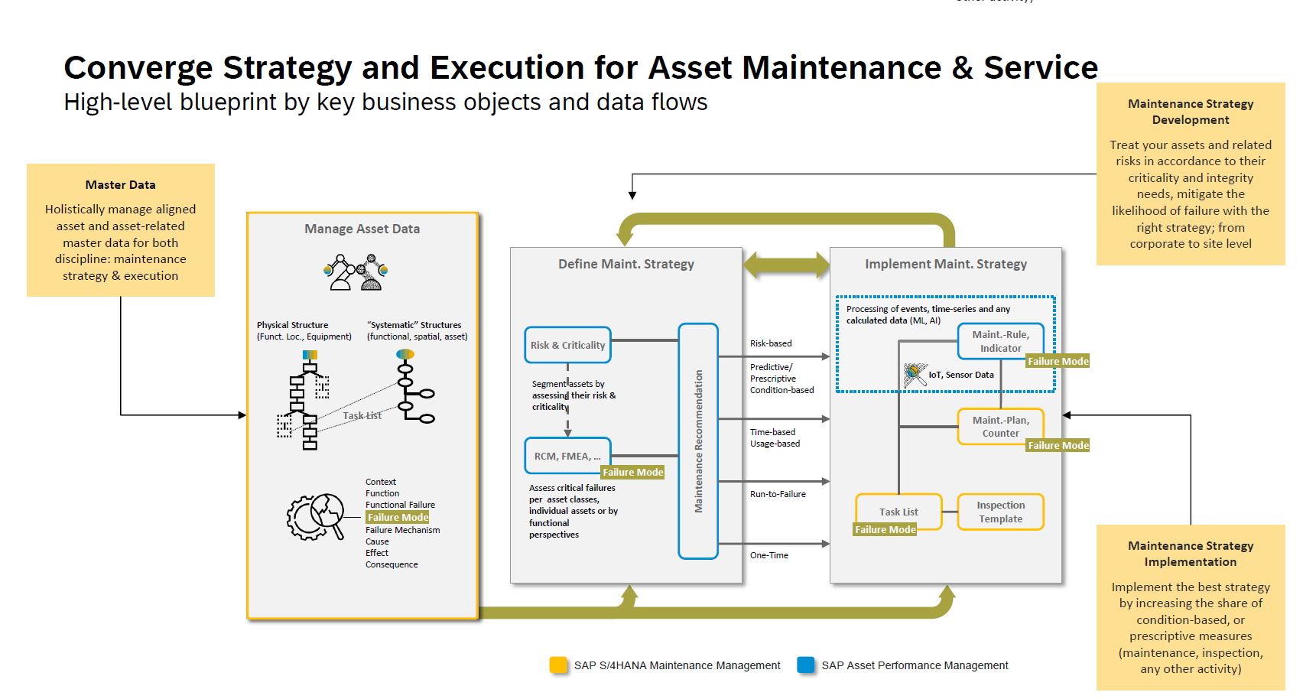
Maintenance Strategy Development
Treat your assets and related risks in accordance to their criticality and integrity needs, mitigate the likelihood of failure with the right strategy; from corporate to site level
Master data
Holistically manage aligned asset and asset-related master data for both discipline: maintenance strategy & execution
Maintenance Strategy Implementation
Implement the best strategy by increasing the share of condition-based, or prescriptive measures (maintenance, inspection, any other activity)

Slide 22
APM & SAP ERP - Asset Strategy Master data Integration
APM SAP ERP
Class
Centrifugal Pump
Class
Centrifugal Pump
Operating Context and
Condition
Submerged/Dirty
Characteristics
Values
Submerged/Dirty
Code Group -
Object Parts (B)
Maintainable Items
Bearing Radial
Failure Mode
Failed to Start On Demand
Code Group -
Overview of Damages (C)
Failure Mechanism
Breakage
Code Group -
Codes (D)
Catalog Profile *
Operating Context and
Condition
Submerged/Clean
Causes
Operation Error
Code Group -
Causes (5)
Maintainable Items
Impeller
APM
Failure Effects
Failed to Start
Code Group -
Failure Effects (6)
APM -Optional
SAP ERP
Recommendations
*Failure Data Profile in APM

Slide 23





SAP Asset Performance Management
Monitor Asset Health and Maintenance Demand
Asset and Asset Performance Data
Data Usage and Monitoring
Demand Generation
Asset Maintenance Demand Processing
Set up rules to automate turning data into defined actions such as alerts or maintenance/service demand or examine and view the data in dashboards or overview pages
Automatically create maintenance or service demand in a well pre-scribed way using rules or by manually converting alerts into dedicated demands
Use indicator time series, asset master data or transactional data like historic notifications, alerts from SAP IoT and SAP Maintenance or Service Management as a foundation to monitor asset health and create maintenance/service demand
Automatically create maintenance or service demand in a well pre-scribed way using rules or by manually converting alerts into dedicated demands
AI models to derive insights
Engineer
Gate Keeper / Coordinator
Leverage AI models like anomaly detection or Weibull algorithm to derive insights such as an anomaly score or probability of failure
Engineer
Planner
Data specialist / Scientist
Data specialist / Scientist
Copyright © 2025 Accenture. All rights reserved.

Slide 24
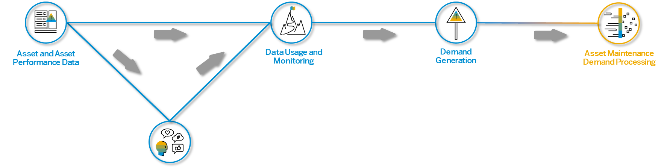
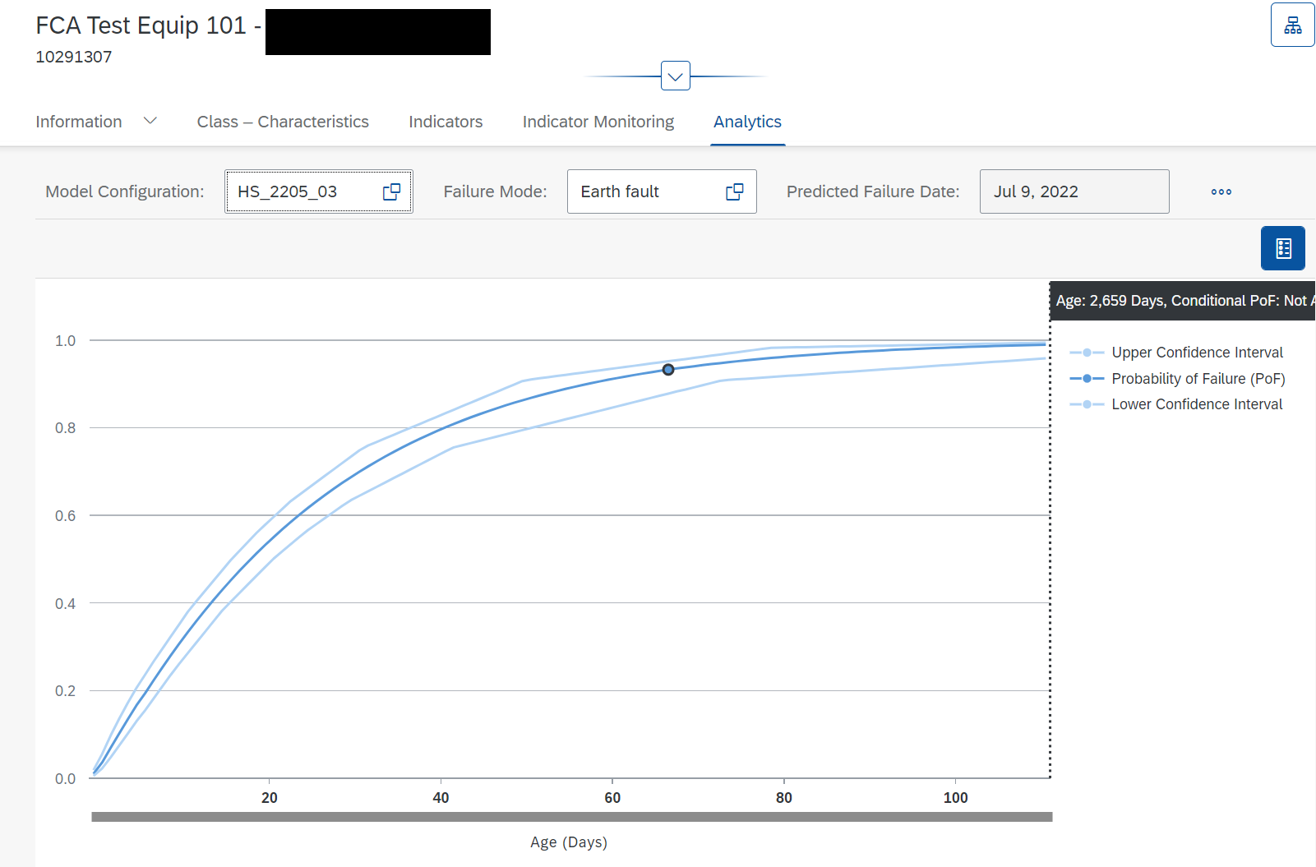
AI Models to Derive Data Monitor Asset Health and Maintenance Demand
Leverage AI models to process data and gain further insights based on time series data, events, transactional or master data
Use out of the box models like anomaly detection or Weibull algorithm to process raw data
Derive data like anomaly score or probability of failure*
Determine leading indicators that contribute the most to an asset health or failure*
Calculate an indicator forecast to show trends of indicator values
Store derived data against the asset indicators to gain and provide deeper insights into the asset health
Figure: Technical Object Page → Analytics → Failure Curve
*Available in SAP Predictive Asset Insights and is a roadmap item for SAP Asset Performance Management

Slide 25
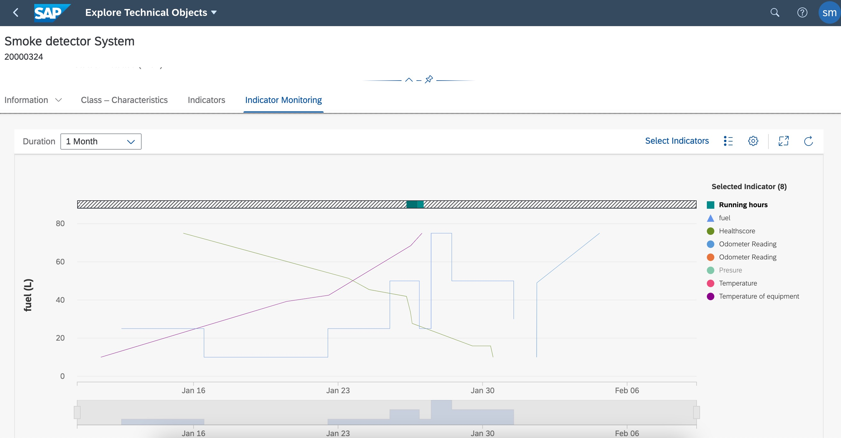
Data Usage and Monitoring Monitor Asset Health and Maintenance Demand
Set up rules to automate creation of maintenance demand or use the data to examine and analyze the health of your asset or fleet
Create rules of different types (calculated rules, scheduled rules, hierarchical aggregation rules, triggered rules, streaming rules) using operators for a set or individual technical objects
Leverage different rule outputs like calculated indicators, creation of notification with assigned task lists or alerts and emails
Monitor the health status or the condition of assets or fleets
Use analytics, charts and dashboards to manage and monitor key data for single technical objects or an entire fleet
Figure: Indicator Chart

Slide 26
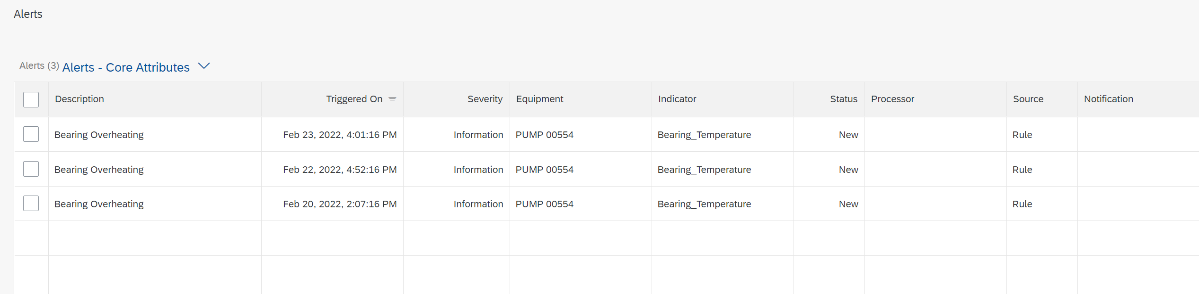
Demand Generation Monitor Asset Health and Maintenance Demand
Create maintenance/service demand by converting generated alerts into notifications (subsequent work orders) in S/4HANA Maintenance Management
Review created alerts and create maintenance/service notifications for the same
Monitor and review context information or maintenance history associated with the generated alerts and failures for technical objects or fleets to qualify alerts
Use rules with asset health and condition to auto-generate notification and work orders*
Out of the box re-use of aligned master data and configuration for notification types, priorities
Use rules with pre-defined task lists to further specify and qualify the maintenance/service demand
*Roadmap item for SAP Asset Performance Management
Notes:
- Replace Screenshot. → Put in Release Quarter (Q3 and Q4)

Slide 27




SAP APM ARCHITECTURE (Asset Health SAP IoT)
Cloud or On premise Environment
Internet
BTP
Equipments
SAP ASSET Performance Management
Asset Health Monitoring
Push\Pull
Indicators
Rules
Alerts Notifications & Orders
Historian
AI & Predictive Modeling
Visual Inspection
AI Model & Extensibility
Configuration
CSV Files
Anomaly Detection
Failure Curve Analytics
Historical Data
Users
SAP S/4HANA Cloud/On premise
Asset Management
Copyright © 2025 Accenture. All rights reserved.

Slide 28
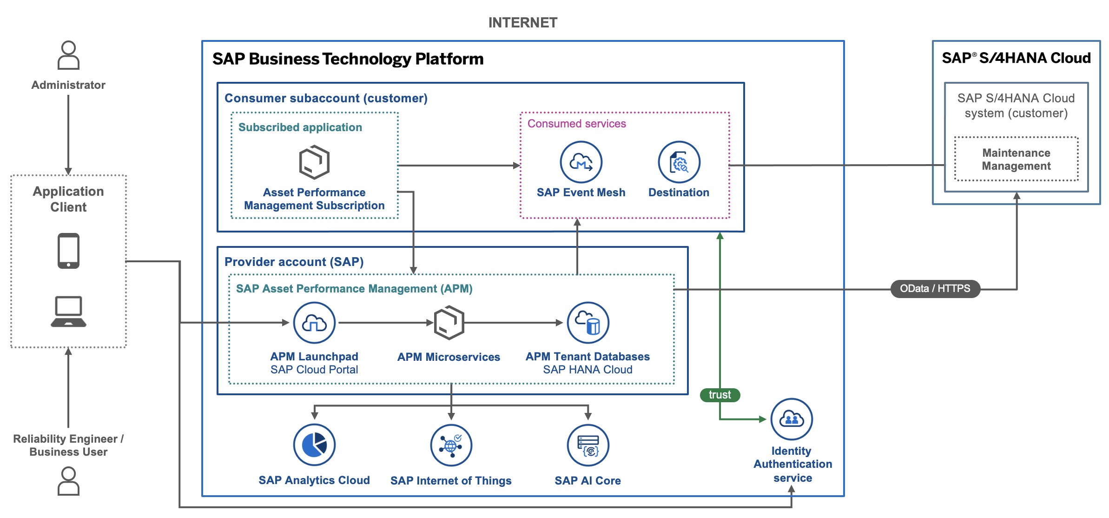
SAP APM with SAP S/4HANA Cloud

Slide 29
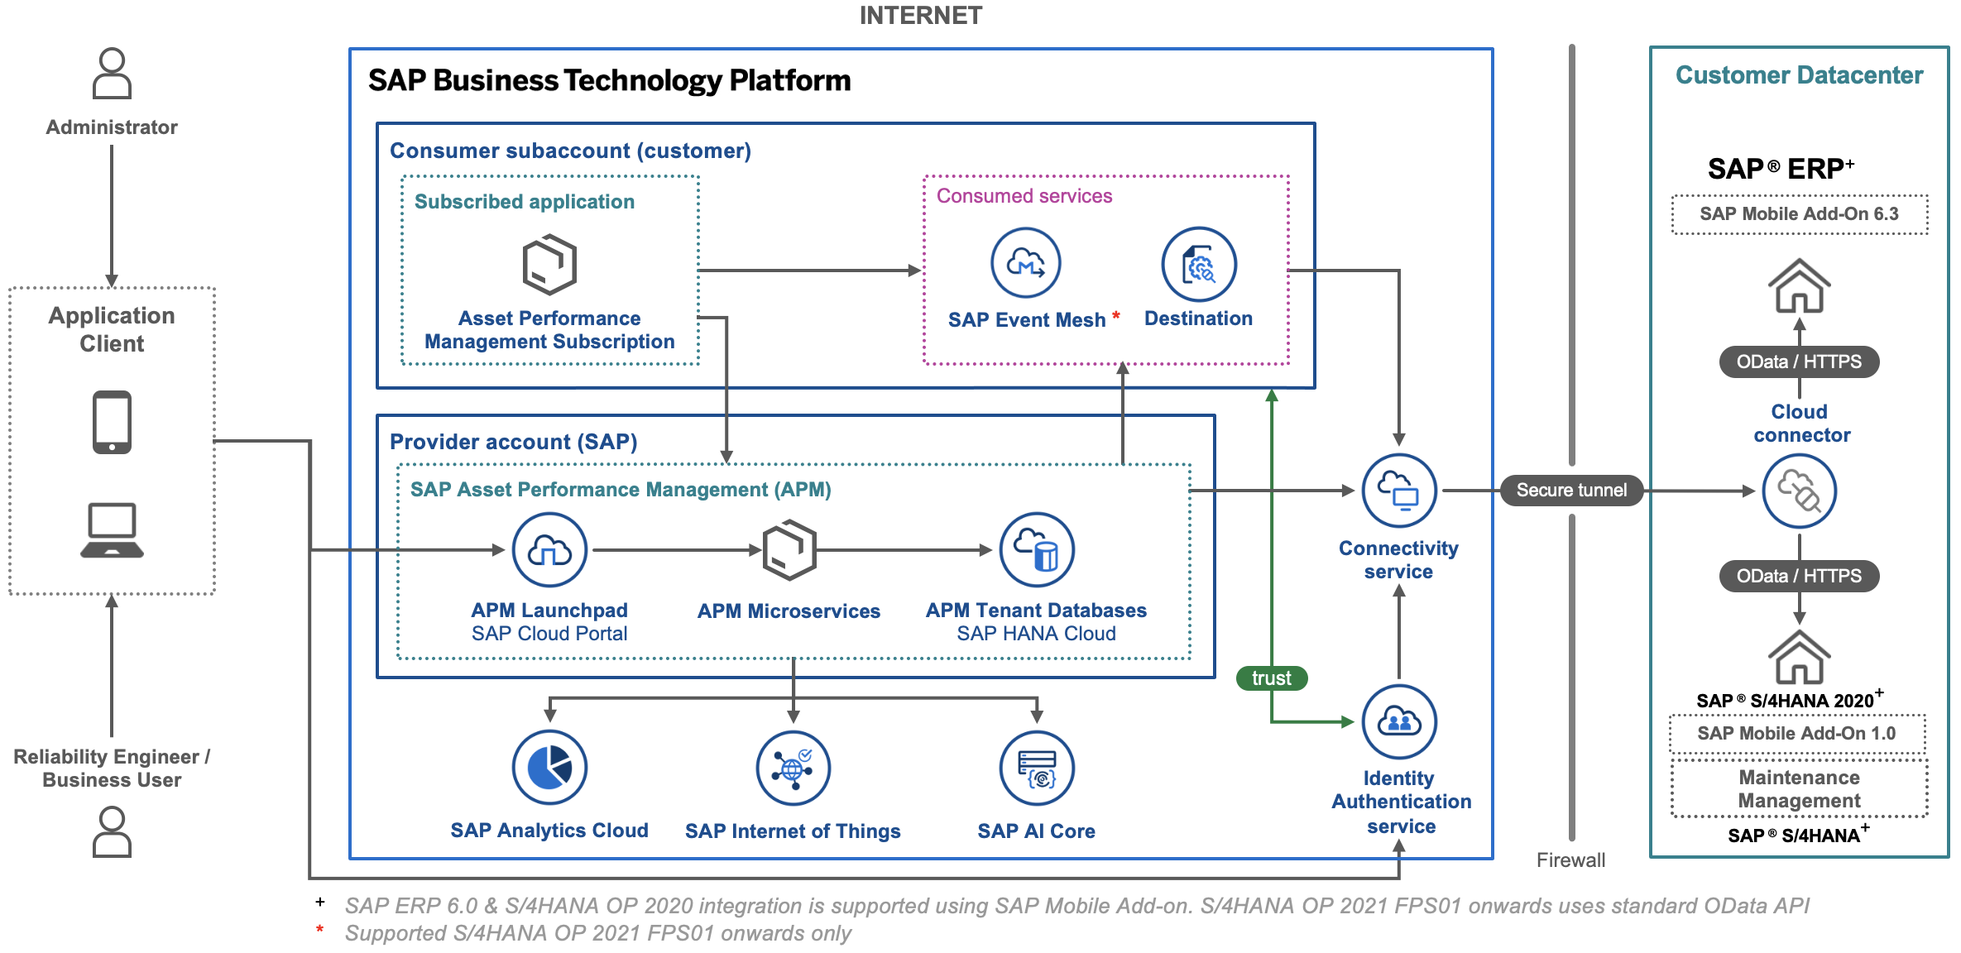
SAP APM with SAP S/4HANA On-Premise or SAP ERP

Slide 30
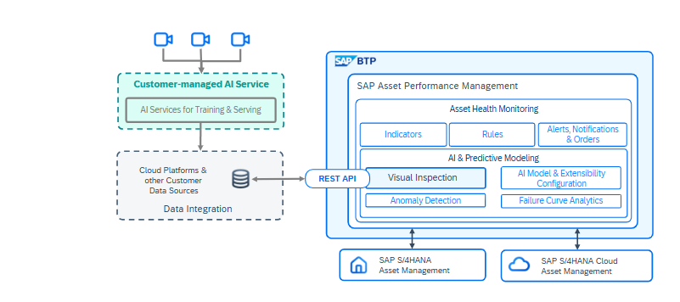
SAP APM – Visual Inspection Architecture

Slide 31
Why Accenture?
How Accenture Delivers Value
04

Slide 32
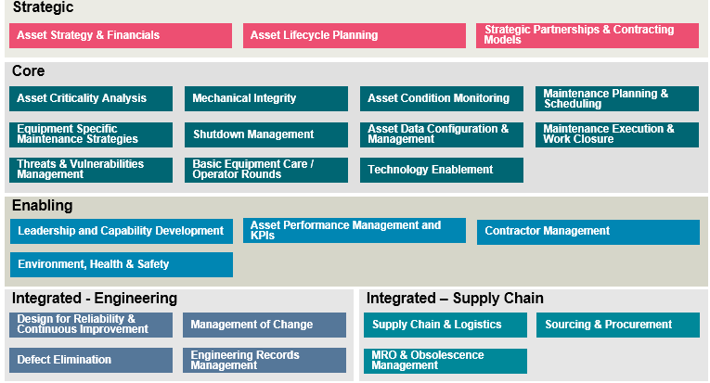
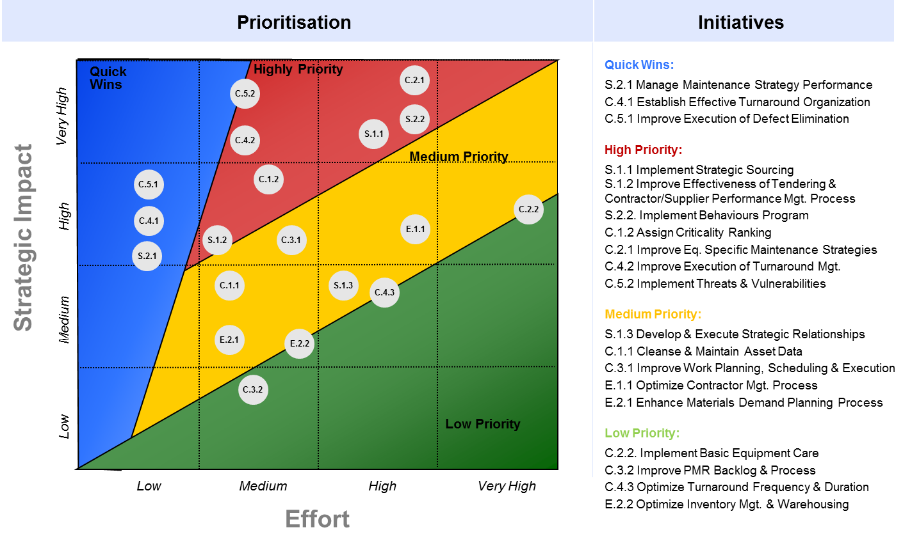
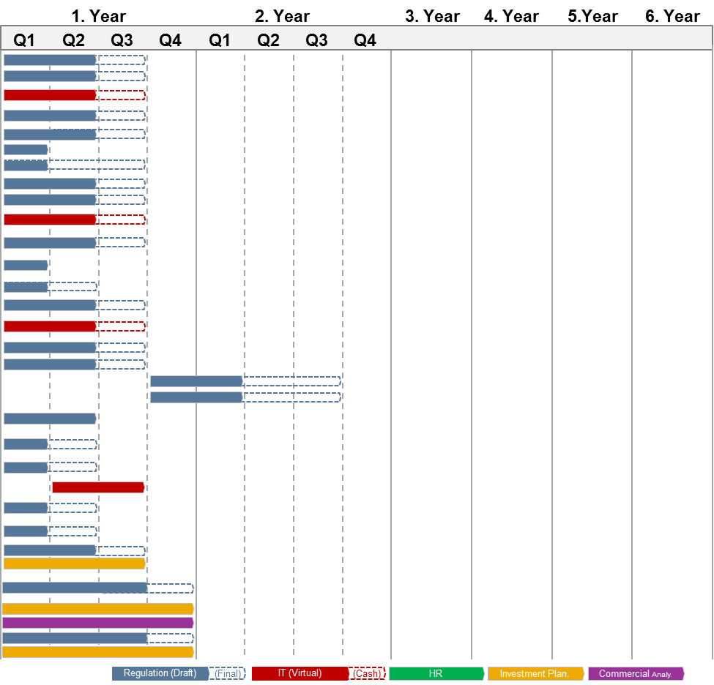
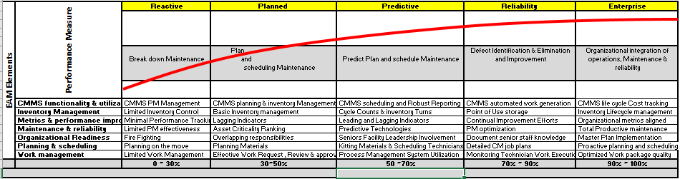
Asset Reliability And Maintenance Management
High level Systematic method to implement maintenance strategies to improve plant availability…
Assessment of As-is processes
Develop Strategies
Implement Strategies
Monitor effectiveness
Improvement Cycle
Deploy ARMM for survey and analyze the survey results
Analyze MTTR and MTBF of critical assets
Identify the challenges and GAPs in the current operating model for Maint. & TAR Execution
Interview with plant operations and maintenance personnel
Carry out Risk Assessment & equipment criticality assessment
FMEA study
Identify equipment for condition-based maintenance, time based and online monitoring systems
Develop equipment specific maintenance plans, task lists etc.
Configure the maintenance plan in CMMS
Assign equipment specific tasks list and configure frequency as per factory period
Implement predictive models wherever deemed necessary and develop dashboards for the same
Monitor equipment healthiness in the dashboard
Analyze the insights generated
PM / PdM schedule compliance reports
Record observations
Analyze overall plant availability & production
Documentation and knowledge transfer
Analyze past observation and performance of equipment
Incorporate learnings and revise task lists and maintenance plans and strategies
Improve & upgrade overall cycle
Configure and re-deploy strategies into CMMS
32
This slide showcases Accenture-led consulting initiatives that are independent of any SAP solution or program.
Copyright © 2025 Accenture. All rights reserved.

Slide 33
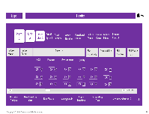

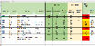
Failure Modes & Effects Analysis (FMEA)
Approach
FMEA STRATEGY
FMEA EXECUTION
Build FMEA methodology
Outcomes
ACTIVITY
Configure Tool
Perform FMEA
Review existing procedures
Define failure mode scoring guidelines
Develop FMEA strategy playbook
Define scoring guidelines based on safety, environment and production impact
Select object type for FMEA
Identify failure modes
Identify failure impact and consequences
Identify detectability, severity and occurrence of failure
Calculate Risk priority number
Failure Modes & effects
Maintenance Tasks
Operational checklists
Digitization opportunities
Upload asset hierarchy & classes/object type
Update scoring guidelines
Assign recommendation
Recommend maintenance task against each failure mode
FMEA playbook
Accelerators
Indicative Deliverables
Asset Reliability Manager: Accenture has inhouse developed FMEA tool which can accelerate the FMEA execution process
RCM recommendation library
FMEA library
Failure Modes Library – Accenture has asset class-wise failure mode library which can be tailored as per clients’ business
FMEA/RCM process and methodology
This slide showcases Accenture-led consulting initiatives that are independent of any SAP solution or program.

Slide 34
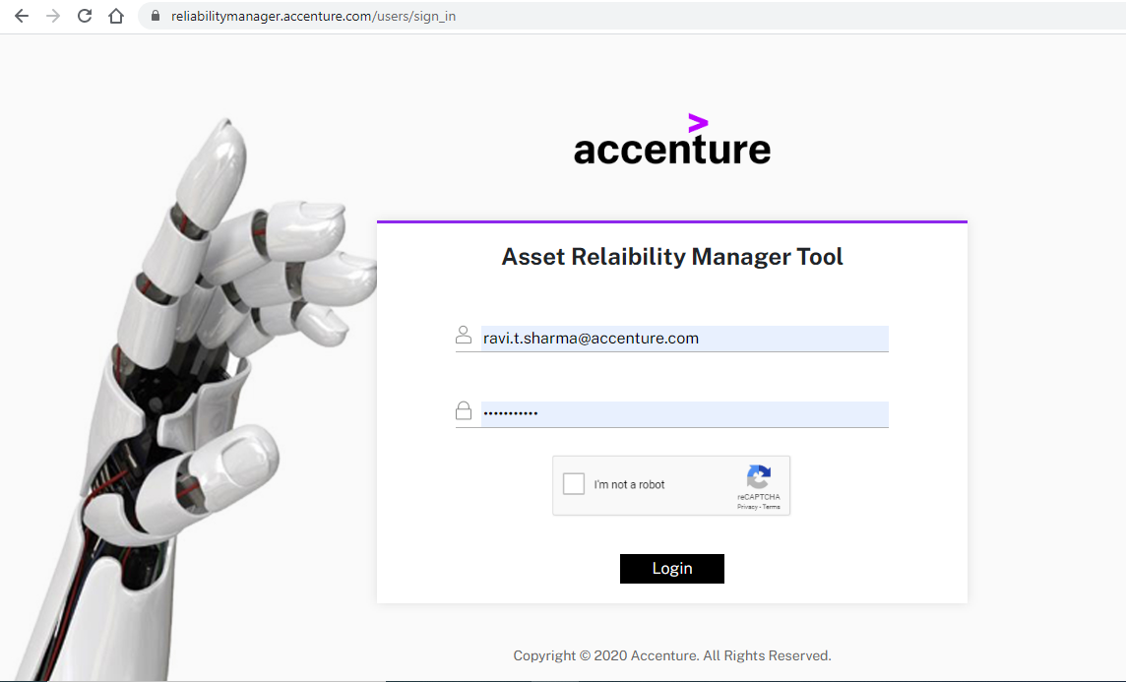
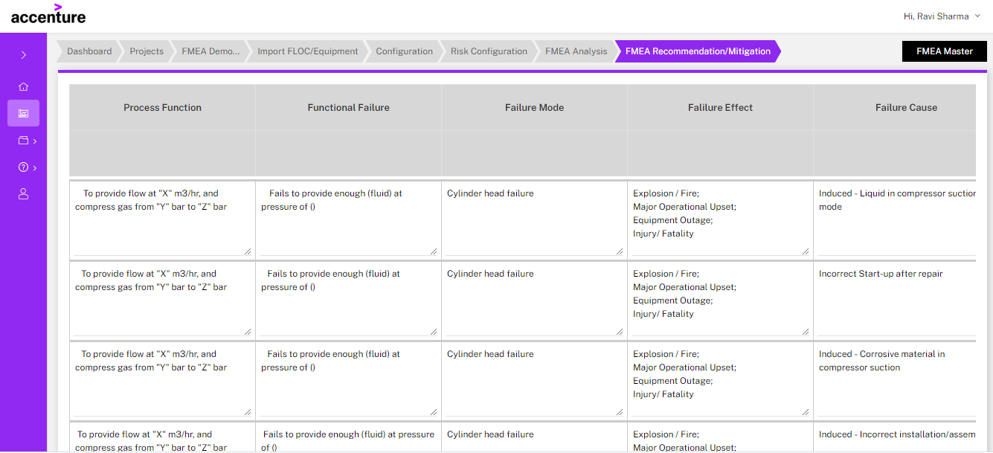
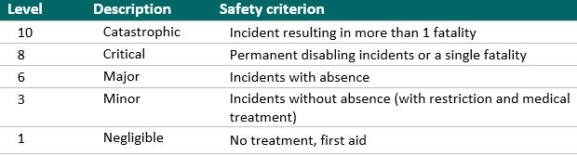
Reliability Centered Maintenance (RCM)
RCM ensures the inherent designed reliability of a process system through the understanding and discovery of system functions, functional failures, failure modes and failure effects and develops mitigating tasks for each failure mode identified during the analysis based on the SAE JA1011 standard
Outcomes
Identify SYSTEM & Define Boundary
Identify Failure Mode, Causes & Effect
Assess Associated Risk
Develop
Maintenance
Strategy
Build Maintenance Task
Select the System based on failure effect on operations and costs of repair and maintenance
Define Function boundary, input and output
Define the ways in which the system can fail
Identify the root causes of the failure modes
Assess the effects of failure
Equipment failures may affect HSE, operations, and other equipment
Assess the Severity of Failure
Assess the Detectability of Failure
Assess the Occurrence of Failure
Define the maintenance tactic against each failure
Assign recommendation to prevent the failure
Define the frequency of task
Review the recommendation
Cluster and optimize task based on work center, system condition and maintenance activity
Assess the spare parts
Build maintenance task list and plan
Potential functional failures
Cause & Effect of failures
Maintenance Tasks
Condition monitoring recommendation
Maintenance Plan/Item
Activity Details
Tools & Enablers
Reliability Manager Solution
Failure Modes Library
Risk Matrix Components
This slide showcases Accenture-led consulting initiatives that are independent of any SAP solution or program.

Slide 35
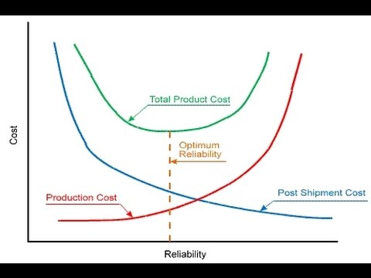
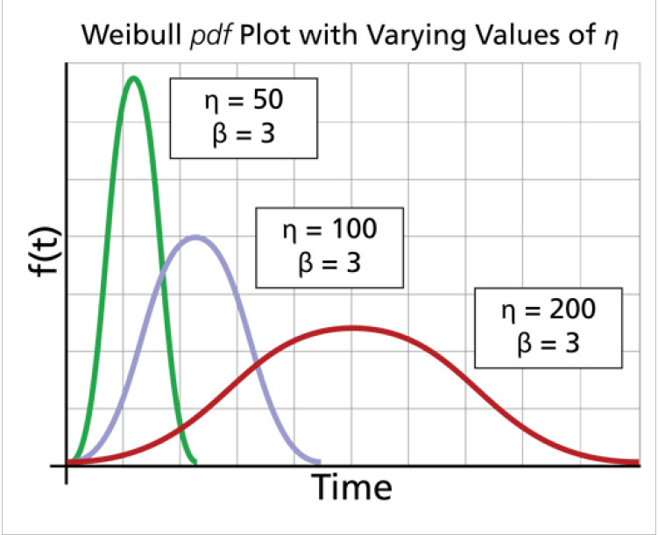
Reliability Modelling: Replacement Freq Optimization
Frequency for scheduled replacement of components has to be kept optimum to ensure acceptable level of reliability for the asset while minimizing the maintenance cost
Outcomes
Data collection and data clean up
Identify components for SCHEDULED replacement
Recommend optimum frequency and seek validation
Perform reliability modelling via Weibull distribution
Gather asset & maintenance Work Order & Notification data from the system
Gather any other data required to calculate Mean Time Between Failures (MTBF), Mean Time to Repair (MTTR) and reactive and preventive maintenance cost
Clean and structure the data to know about material consumption at specific asset location
As part of Maintenance Strategy review, identify the components chosen for Scheduled Replacement
Components which undergoes wear and tear with time or have a high-risk potential are generally the ones selected for Scheduled Replacement
Identify the material that is used for these components
Create data templates with all the necessary inputs for Reliability modelling to be fed into any Reliability Modelling tool such as GE APM tool
If tool not available, code can be built on tools such as MS Excel/Python
Run the data model on these tools
Obtain the optimum replacement frequency
Seek approval on the recommendation with the relevant stakeholders
List of components for Scheduled Replacement
Material used for such components, which can be added in the task list of change out plans
Optimum replacement frequency for the component
Activity Details
Tools & Enablers
Reliability Modelling
Weibull Distribution curve
This slide showcases Accenture-led consulting initiatives that are independent of any SAP solution or program.

Slide 36
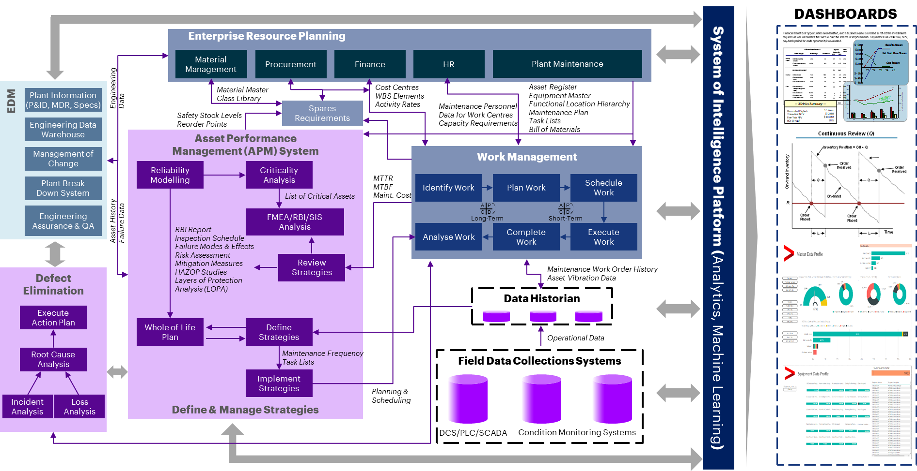
Integrated APM Systems Deployment
We help deploy a fit for purpose APM solution using our reference architectures
System of Intelligence Platform (Analytics, Machine Learning)
Dashboards
Enterprise Resource Planning
Value/ Benefits:
EDM
Material Management
Procurement
Finance
HR
Plant Maintenance
Plant Information (P&ID, MDR, Specs)
Engineering Data
Material Master Class Library
Increased operational efficiency
Safety Stock Levels Reorder Points
Spare Requirements
Cost Centres WBS Elements Activity Rates
Maintenance Personnel Data for Work Centres Capacity Requirements
Asset Register Equipment Master Functional Location Hierarchy Maintenance Plan Task Lists Bill of Materials
Engineering Data Warehouse
Asset Performance Management (APM) System
Management of Change
Work Management
Improved asset lifecycle management
Reliability Modelling
Criticality Analysis
Plant Break Down System
Asset History Failure Data
MTTR MTBF Maint. Cost
Identify Work
Plan Work
Schedule Work
List of Critical Assets
Long-Term
Short-Term
Engineering Assurance & QA
FMEA/RBI/SIS Analysis
Analyse Work
Complete Work
Execute Work
RBI Report Inspection Schedule Failure Modes & Effects Risk Assessment Mitigation Measures HAZOP Studies Layers of Protection Analysis (LOPA)
Improved asset reliability
Defect Elimination
Review Strategies
Maintenance Work Order History Asset Vibration Data
Data Historian
Execute Action Plan
Whole of Life Plan
Define Strategies
Maintenance Frequency Task Lists
Operational Data
Optimal maintenance spend
Root Cause Analysis
Implement Strategies
Field Data Collections Systems
Planning & Scheduling
Incident Analysis
Loss Analysis
Define & Manage Strategies
Increase in planning & scheduling efficiency
DCS/PLC/ SCADA
Condition Monitoring Systems

Slide 37

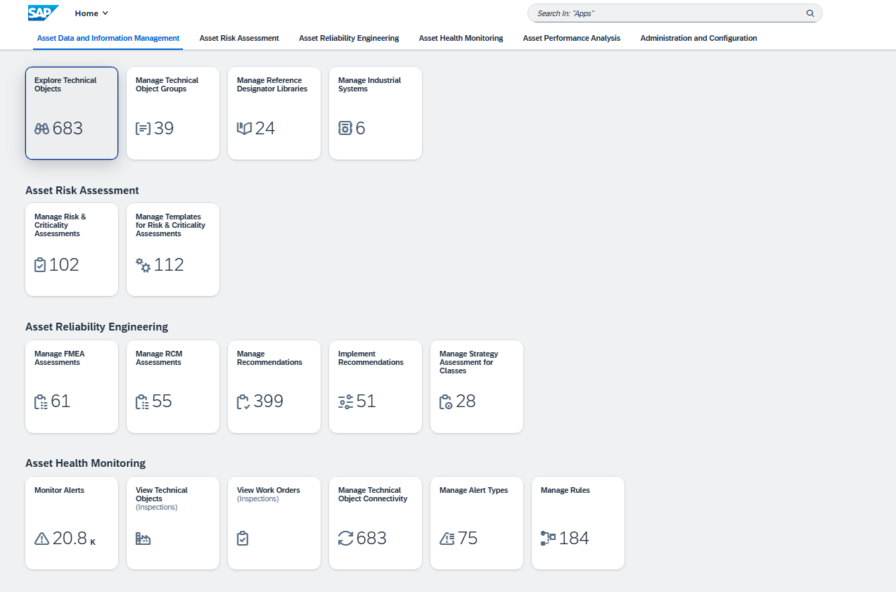
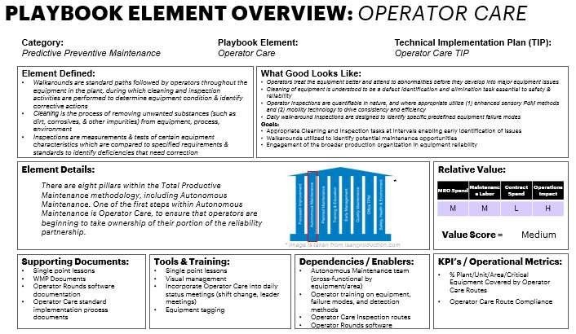
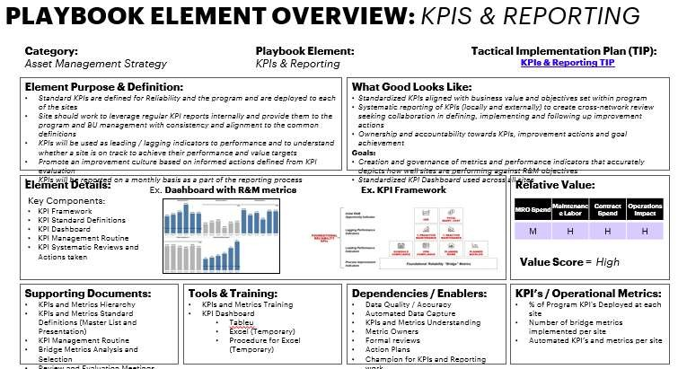
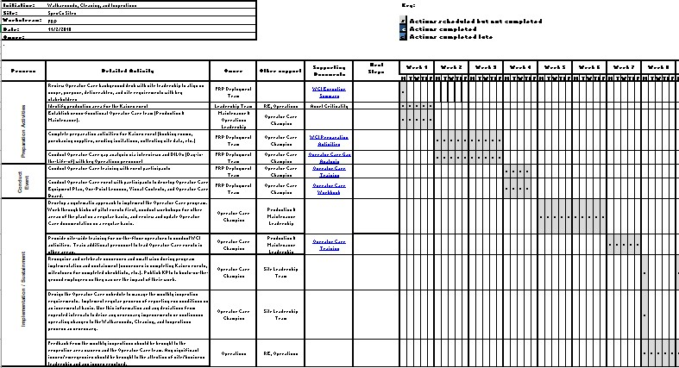
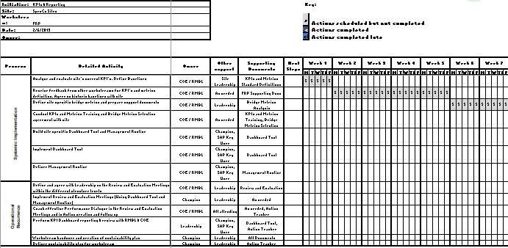
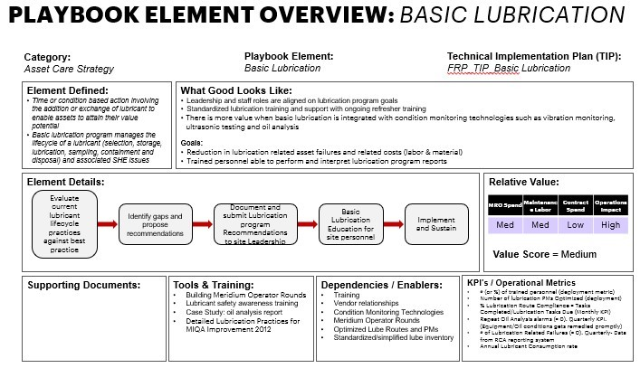
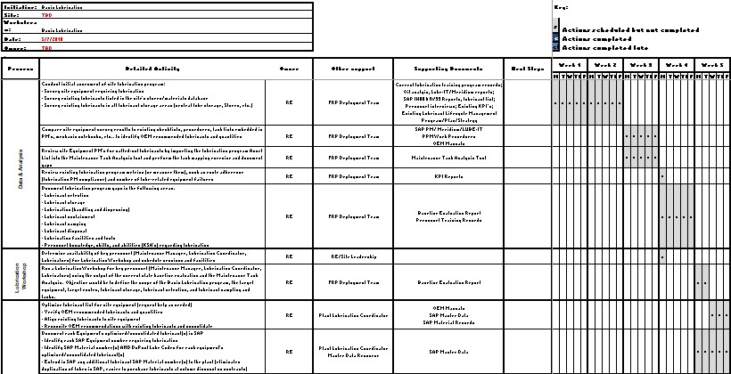















Our Unique Enablers/Tools Accelerate The Pace Of Engagement Delivery
SAP APM | Initial Set Up
(Steps + Video)
SAP APM | Initial Set Up
(Steps + Video)
SAP APM | Catalog Profile
SAP APM | Templates & Useful Links
SAP APM | Catalog Profile
SAP APM | Additional Resources
SAP APM | Templates & Useful Links
Guided instructions and video support to configure SAP APM modules quickly and consistently.
Guided instructions and video support to configure SAP APM modules quickly and consistently.
Curated resources to accelerate configuration, assessments, and strategy design using proven templates.
Curated resources to accelerate configuration, assessments, and strategy design using proven templates.
Predefined catalog structures to standardize asset classification and enable efficient data integration.
Predefined catalog structures to standardize asset classification and enable efficient data integration.
Step-by-step guide and video tutorials for performing maturity assessments in asset management practices.
Step-by-step guide and video tutorials for performing maturity assessments in asset management practices.
In Progress
SAP APM | Mass Data Upload Tool
SAP APM | Postman Set Up
(Steps + Video)
SAP APM | FMEA Assessment
(Steps + Video)
SAP APM | RCM Assessment
(Steps + Video)
Automated solution for uploading large volumes of master and transactional data into SAP APM.
Configuration package to connect SAP APM APIs for data exchange and automation using Postman.
Tool-supported workflow to develop and document Failure Mode and Effects Analysis within SAP APM.
Standardized method to perform Reliability-Centered Maintenance assessments using APM tools.
In Progress
In Progress
SAP APM | Local indicators
(Steps + Videos)
SAP APM | Failure Curve Analytics
(Steps + Video)
SAP APM |Manage Industrial Systems
Resource Scheduling (RSH)
Tool to monitor, assess, and manage inspection plans and reliability for industrial systems.
S/4-integrated solution for planning and tracking resource capacity in asset maintenance operations.
Tools and guidelines for defining condition-based triggers and performance indicators in APM.
Video-based guide to applying failure analytics curves for smarter maintenance decisions in SAP APM.
In Progress
SAP APM | Alert Rules Notifications
(Steps + Video)
SAP APM | Anomaly Detection Model (Steps + videos)
SAP APM | Maintenance Flows
SAP APM | Workplan for implementation
Step-by-step guide and video tutorial to configure and activate alert rules for condition-based notifications in SAP APM.
Visual process flows and templates to support standardized preventive and predictive maintenance strategies.
Structured implementation roadmap outlining key phases, activities, and deliverables to accelerate SAP APM rollout.
Video-based guide and documentation to configure anomaly detection models and automate early failure identification.
In Progress

Slide 38

Typical Project Team
ACCENTURE TEAM
Delivery Lead | Coordinates the PoC execution and ensures timely delivery. | 0.5 FTE
Functional Consultant | Supports master data preparation, functional design, and APM configuration. | 1 FTE
Integration Consultant | Manages system integration between S/4HANA, EAM, and APM (BTP). | 0.25 FTE
Data Specialist / Engineer | Supports data extraction, cleansing, structuring, and validation for ingestion. | 0.5 FTE
SAP APM Consultant | Leads APM setup: configuration of catalog profiles, health indicators, and analytics. | 1 FTE
CLIENT TEAM
Product Owner | Represents client needs, sets priorities, and validates progress throughout the PoC. | 0.25 FTE
Maintenance Engineer | Provides asset knowledge, supports functional design, and validates recommendations. | 2 FTE
Data Engineer | Grants access to client systems and supports with data availability and quality checks. | 0.75 FTE
Copyright © 2025 Accenture. All rights reserved.
Notes:
Ensure the titles are not duplicated. Please check the set of best practices.

Slide 39
Representative Credentials & Results
05

Slide 40

Accenture SAP APM Credentials – Snapshot
Internal
Accenture is currently supporting SAP APM implementations across four major global organizations.
Oil & Gas Company: SAP APM is used to support Mechanical Integrity Inspection processes. Accenture provides ongoing support and is leading the rollout to additional plants, with a full-scale deployment planned as part of a broader SAP S/4HANA EAM + APM transformation.
Pharmaceutical Manufacturer: Currently in the Blueprint phase of a digital transformation initiative that includes SAP S/4HANA migration and SAP APM implementation to standardize asset management across production sites.
Consumer Goods Manufacturer: In Blueprint stage for SAP APM implementation, integrated with a wider SAP S/4HANA upgrade program. The focus is on harmonizing asset strategies and improving reliability across manufacturing sites.
Mining Company: SAP APM has been implemented in a South American site. The program includes end-to-end EAM + APM deployment, with plans to expand to other regions.

Slide 41

Use Case: Asset Performance Strategy Alignment Oil & Gas Industry
Client Profile
Business Challenges
Chevron
(Delete before share)
Solution
A leading global energy company undergoing a multi-phase digital transformation. The client is investing in SAP S/4HANA to modernize core enterprise systems across operations, finance, and asset-intensive business units.
Fragmented support structure for legacy ERP systems (ECC, JDE, CFIN), resulting in operational inefficiencies and technical risk.
Limited governance and visibility over SAP technical services across platforms.
Need to align SAP S/4HANA implementation with business platforms while improving service resiliency and standardization.
Outcomes
Established an integrated functional and technical support team to deliver across SAP S/4HANA releases, including APM for Mechanical Integrity inspection Management at fixed Assets.
Adopted a platform-based support model with standardized playbooks, centralized Level 1/1.5 services, and chapter-sourced teams.
Modernized delivery structure through a consolidated managed service provider (MSP) to streamline SAP technical operations.
Defined a phased implementation roadmap to enable scalable execution across programs and regions.
Increased efficiency and agility through unified support structure.
Strengthened reliability and security posture via technical modernization and cyber remediations.
Improved cross-platform alignment and operational excellence.
Accelerated talent enablement and readiness for future S/4HANA waves.

Slide 42

Use Case: Global Asset Strategy Harmonization – Pharmaceutical Industry
Client Profile
Business Challenges
Aztrazeneca
(Delete before share)
Solution
A global pharmaceutical company focused on scientific innovation and the development of life-changing medicines. The organization operates across multiple therapeutic areas and is expanding its R&D capabilities through strategic investments in cutting-edge facilities. With a strong commitment to sustainability and digital transformation, the company integrates science, technology, and environmental responsibility to drive long-term healthcare impact and business growth.
Outcomes
Prior to SAP APM implementation, asset strategies were managed using Excel spreadsheets. Each manufacturing site used its own template, and although this was not initially a major issue, it posed a challenge for standardization and visibility at the global level.
With the ongoing migration from ECC to S/4HANA, the organization saw an opportunity to harmonize asset management processes across all sites.
The implementation of SAP Asset Performance Management (APM) and Service and Asset Management (SSAM) enables:
Standardization of asset strategies across global operations
Unified and structured asset data
Enhanced visibility into asset health and performance, even in sites without prior IoT infrastructure
Better decision-making through centralized, real-time insights
Establishment of a consistent, global model for asset strategy development and execution
Improved governance and cross-site collaboration
Strategic alignment with S/4HANA transformation initiative
Copyright © 2025 Accenture. All rights reserved.
Notes:
Making-Reinvention-Real-With-GenAI-TL.pdf
Technology Vision 2025

Slide 43
Use Case: Asset Performance Strategy Alignment – Food Industry
Client Profile
Business Challenges
MdiasBranco
(Delete before share)
A leading food manufacturing company with multiple industrial complexes, specializing in pasta and biscuit production. The organization operates dozens of distribution centers and has a presence in over 40 countries.
Solution
Efficient asset lifecycle management: Ensure the availability and reliability of critical assets through predictive maintenance and real-time monitoring.
Optimization of operational and maintenance costs: Reduce unnecessary costs by eliminating reactive maintenance and improving preventive activity planning.
Data integration and informed decision-making: Unify APM with SAP S/4HANA and other systems to gain a comprehensive view of asset performance and enhance data-driven management.
Master data quality issues: Existing information in SAP S/4HANA had inconsistencies, requiring analysis and adjustments to ensure reliable data in APM.
Standardization of risk and criticality assessment: Different facilities used various methodologies for evaluating risk and criticality, making it necessary to define a unified approach adaptable to APM.
Outcomes
Accenture designed and executed a plan to assess, configure, and deploy SAP APM across three pilot sites, with future expansion in mind. The approach included system integration with S/4HANA, data cleansing and alignment, development of unified risk and reliability assessment frameworks (FMEA and RCM), and delivery of targeted training sessions supported by documented materials.
SAP APM was successfully synchronized and configured in three pilot plants, establishing the foundation for a broader rollout.
The integration with SAP S/4HANA enabled real-time performance monitoring and a consolidated view of asset health.
Over 32,000 technical objects were cleansed and aligned, resolving critical master data quality issues and improving the reliability of APM inputs.
A standardized framework for Risk & Criticality Assessments was developed and applied across sites.
Over 50 monitoring rules and 40 alert types were created to enhance predictive maintenance and reduce unplanned downtime.
Live training sessions were delivered, and documented study materials were developed to support user adoption and knowledge retention.

Slide 44
Value Tree
06

Slide 45
Value Tree
Typical benefits linked with value drivers and value levers
 | Value Driver | Value Levers | Focus Areas | Typical Benefits
Operational Value | Increased Profitability | Increase Production | Equipment Uptime | + Production throughput (2-5%) + Production schedule attainment
 |  | Reduce Downtime | Availability Losses (planned / unplanned) | - Asset downtime (10-15% reduction in breakdown & unplanned maintenance activities)
 | Reduced OPEX | Reduce costly emergency repairs | Reactive Maintenance Costs, Contractor Costs | + Maintenance productivity - Maintenance costs
 |  | Reduces often unnecessary routine preventive maintenance | Detecting & preventing asset failures, proactive Condition-based and Risk-based Maintenance | + Workforce productivity (5-25% increase in workforce utilization)
 | Increased Capital Efficiency | Improve Asset Utilization | Long Term Asset Planning | + Asset utilization (2-6% higher availability) + Asset lifecycle - Engineering Investments
 |  | Reduce inventory costs | MRO Inventory Optimization | - MRO inventory (5-10% lower inventory cost) Stockouts + Reduced CAPEX, Responsible Business
 | Reduce Operational Risks | Reduce Asset Risks | Asset Integrity, Predictive Analytics | - Safety incidents/LOPC (3-40% reduction in incidents) - Environmental incidents
 |  | Health & Safety | Health Indictors Surveillance | + Brand image / license to operate - Risk for corporate liability
Copyright © 2025 Accenture. All rights reserved.

Slide 46
KPIs for Reliability
Reliability metrics to monitor and optimize performance
Asset
Process
System
Equipment
Operational
Organizational
Mean Time Between Failures (MTBF)
Mean Time To Repair (MTTR)
Preventive maintenance to corrective maintenance ratio
% of Critical spares in stock
% of Critical assets covered maintenance plans
% of Critical rotating equipment under rotable
Overall Vibration and temperature (Precision maintenance)
Lubrication cleanliness
Plant availability
Work Order Cycle time (for found corrective)
PM & CM Compliance
Schedule Compliance Percentage
Rework Percentage
Maintenance Cost as % of RAV
Overall Equipment Effectiveness (OEE)
Total Effective Equipment Performance (TEEP)
Training Hours/Cost per person
Number of accidents
Lagging Performance Indicators
Leading Performance Indicators
Copyright © 2025 Accenture. All rights reserved.
Notes:
Leading and Lagging KPIs

Slide 47








Contributors & SMEs
Mark Pyatt
SAP NA IAM Lead
SAP NA GTM Lead
Ames Onthuam
SAP IAM Delivery Lead
David McGinnis
NA APM Lead
IM
Isabel Martins
APM EMEA Lead
Luciano Rodrigues
LATAM IAM Lead
Gabriel Calabia
LATAM IAM Lead
Nikhil Koolwal
SAP IAM ATCI Lead
Facundo Ciancaglini
SAP APM Consultant
Denise Colaso
IAM Consulting Analyst
AK
Abhijit Kumar
Advanced App Engineering Analyst

Slide 48

THANK YOU

